Slide 1
At the Light of Love High School at Yenangyaung

Slide 2
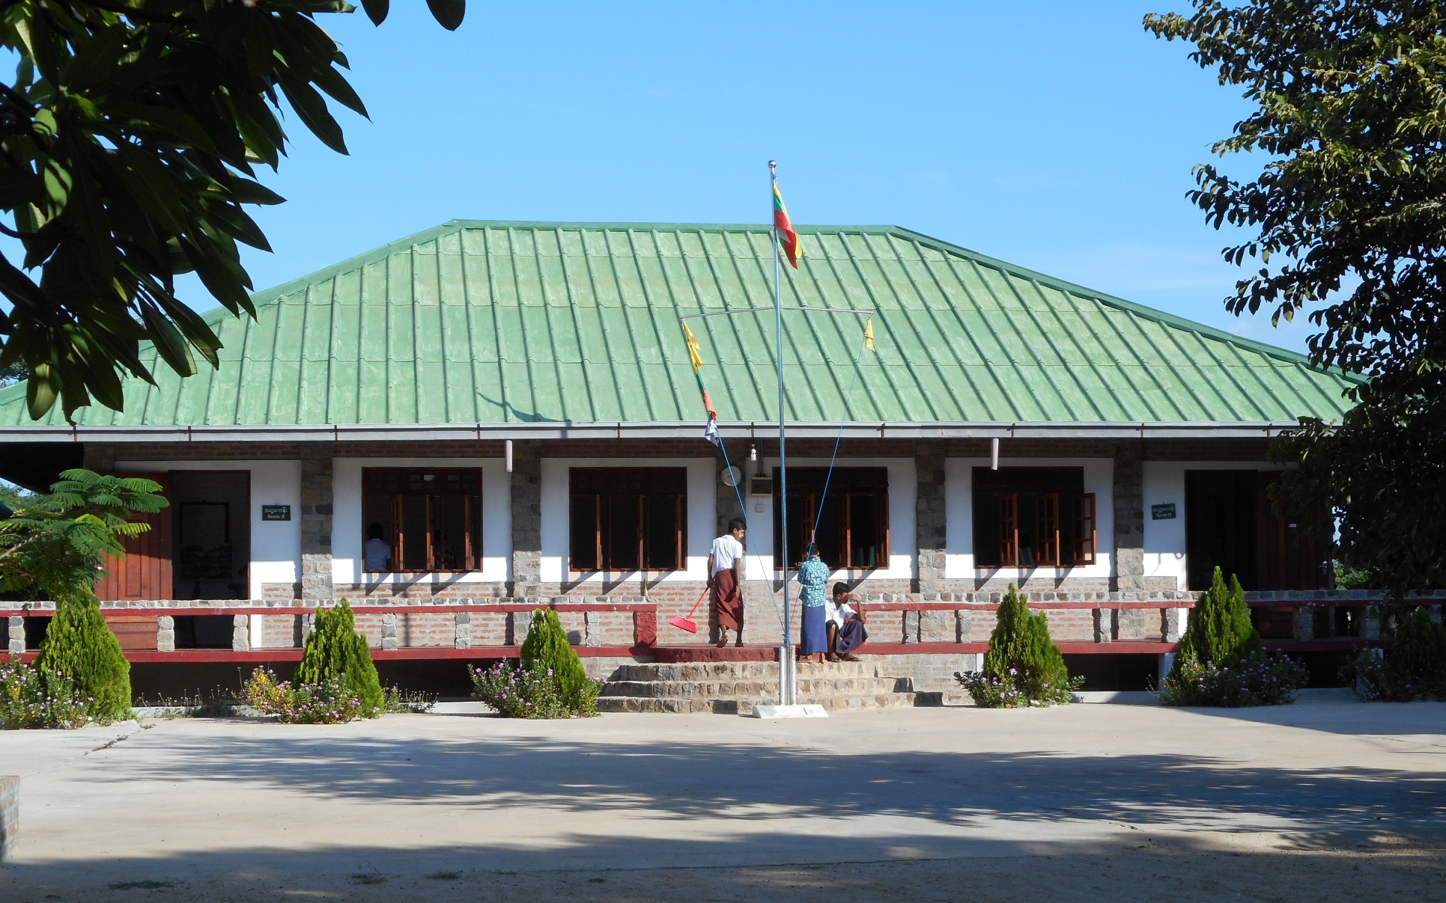
The school buildings look stately -

Slide 3
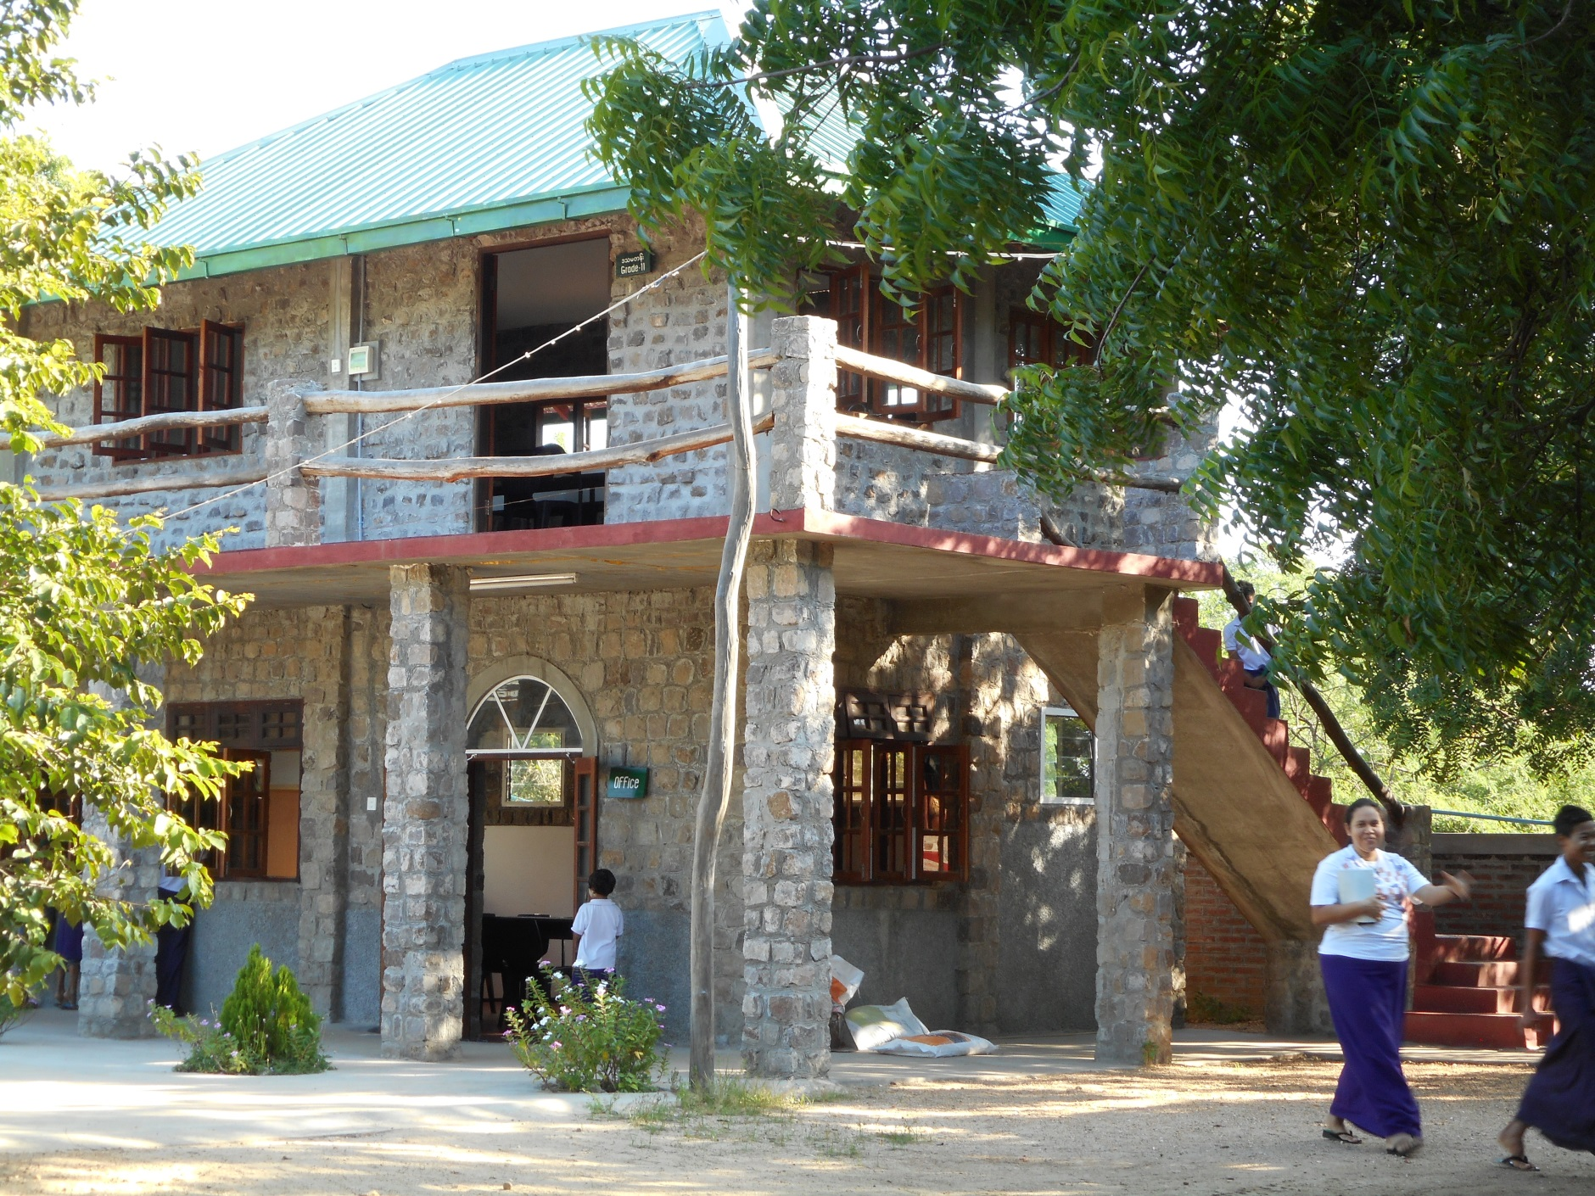
two of them have two storeys.

Slide 4
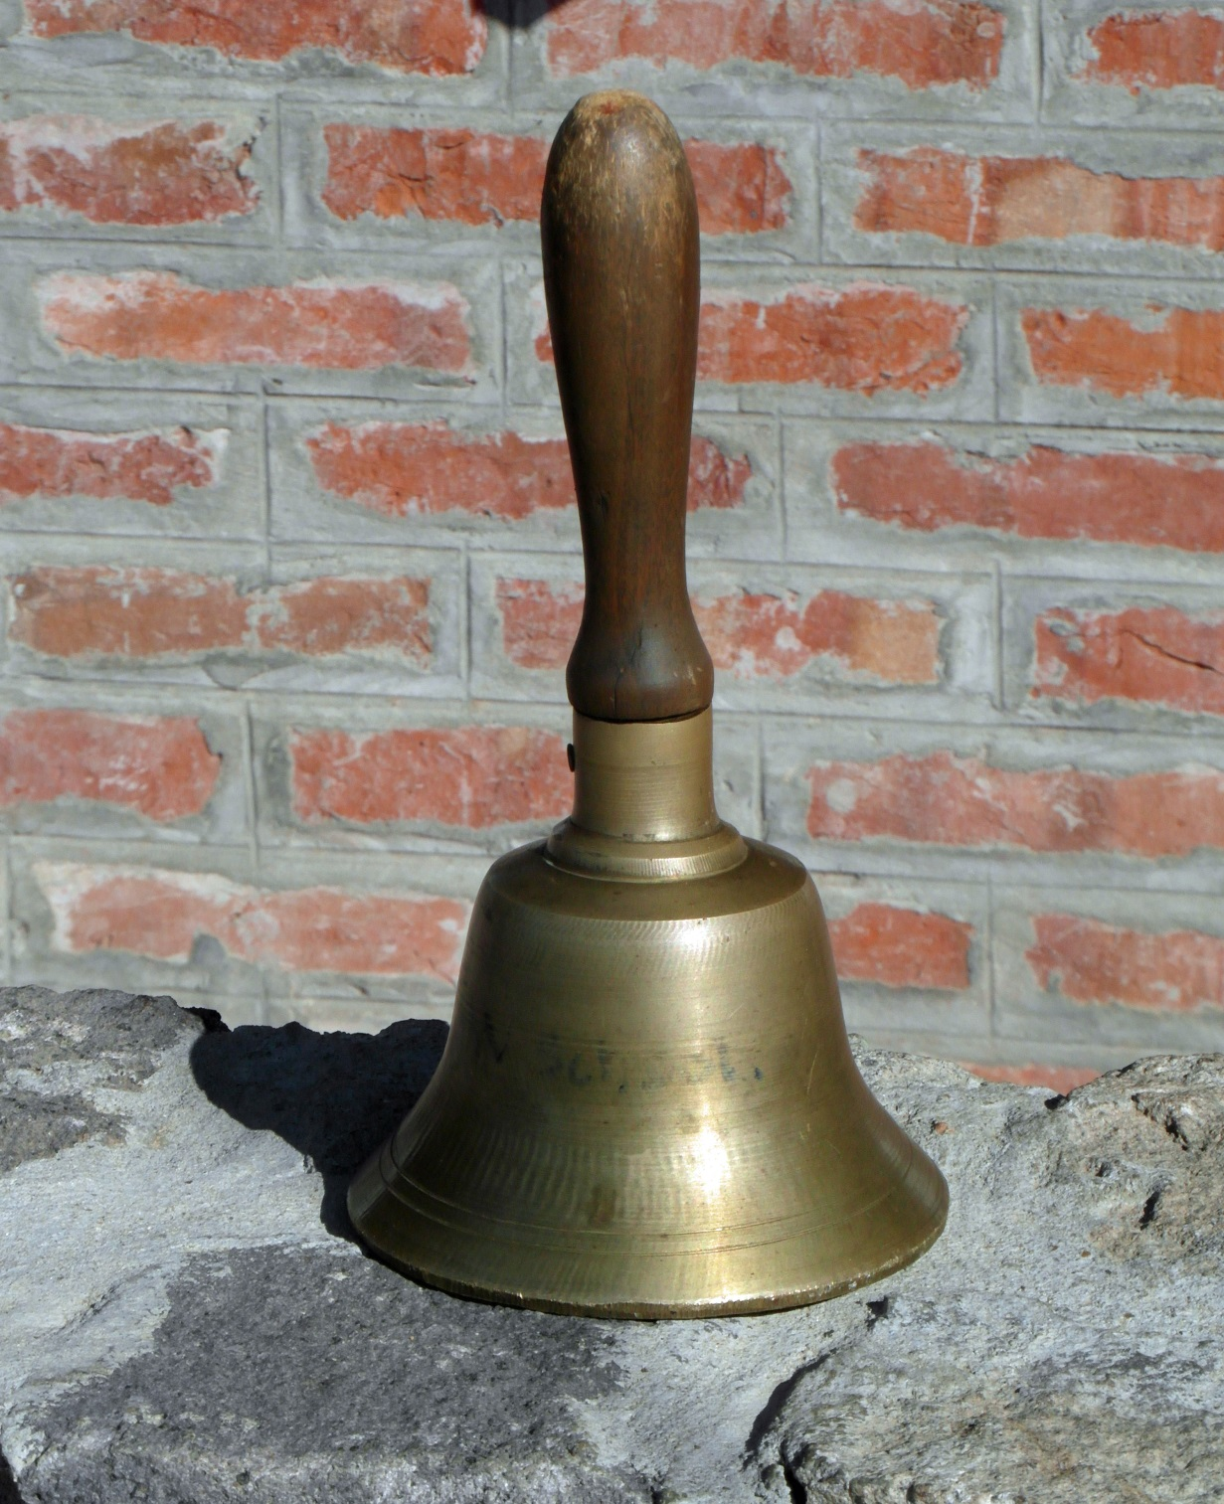
The school bell

Slide 5
Roll call on Monday morning

Slide 6
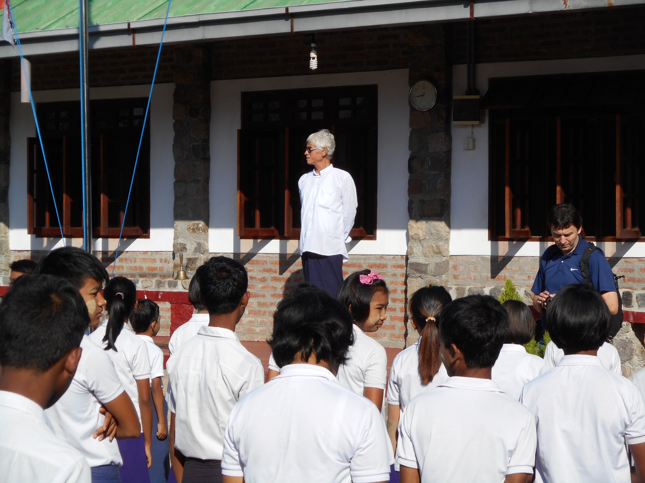
CEO Eric opens the week.

Slide 7
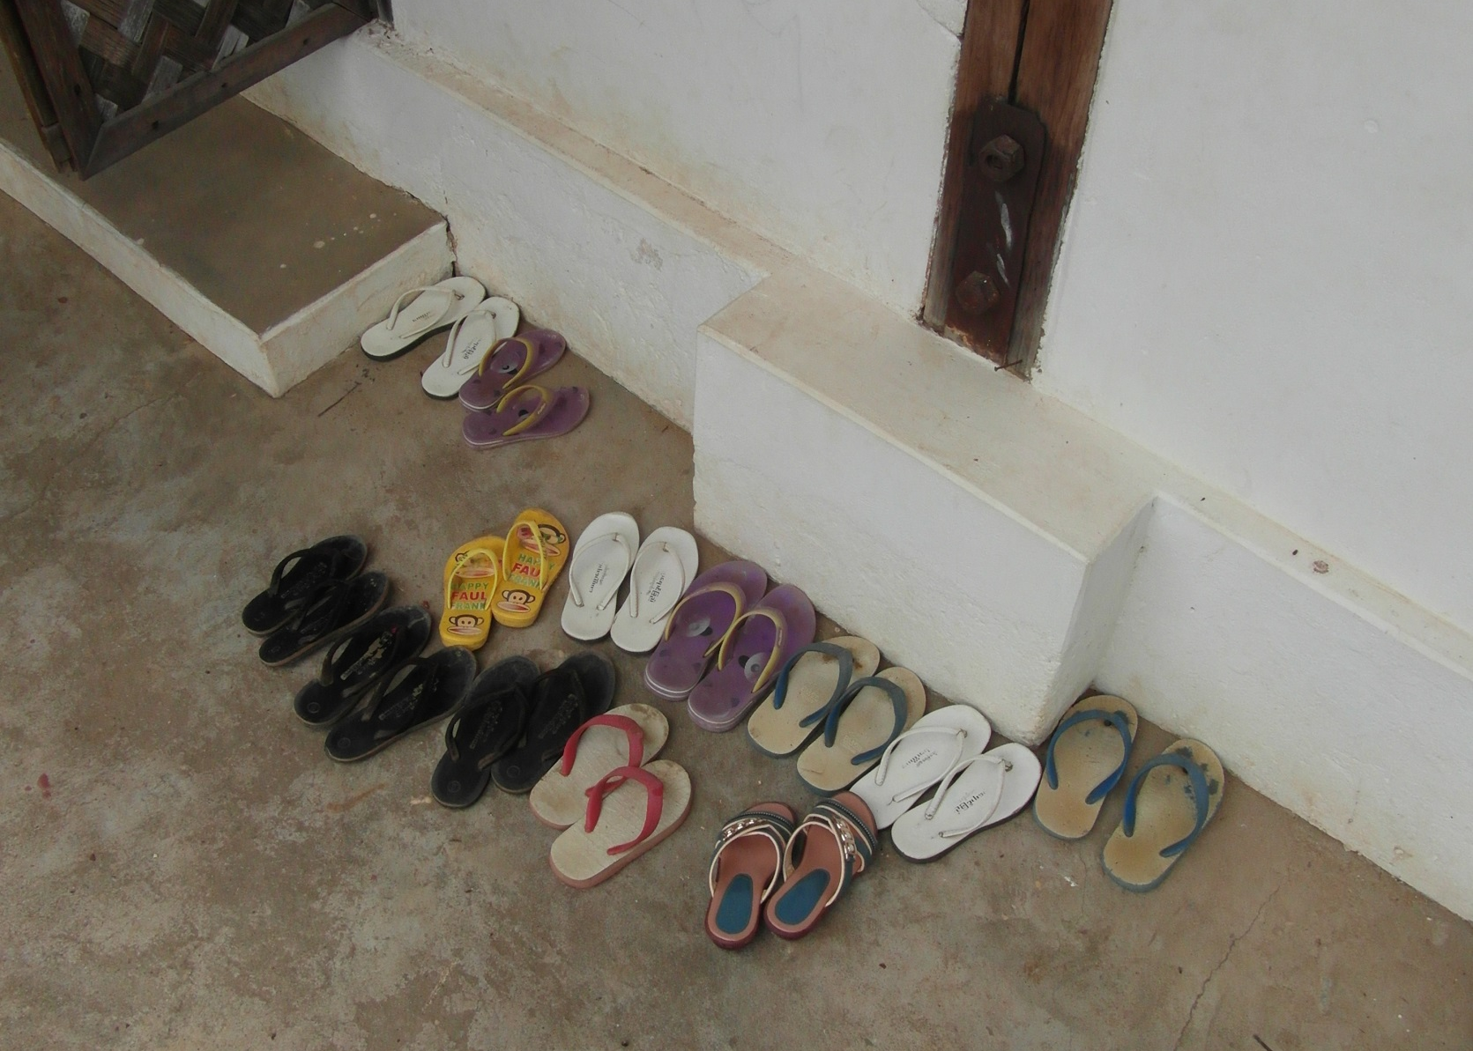
In front of the classroom

Slide 8
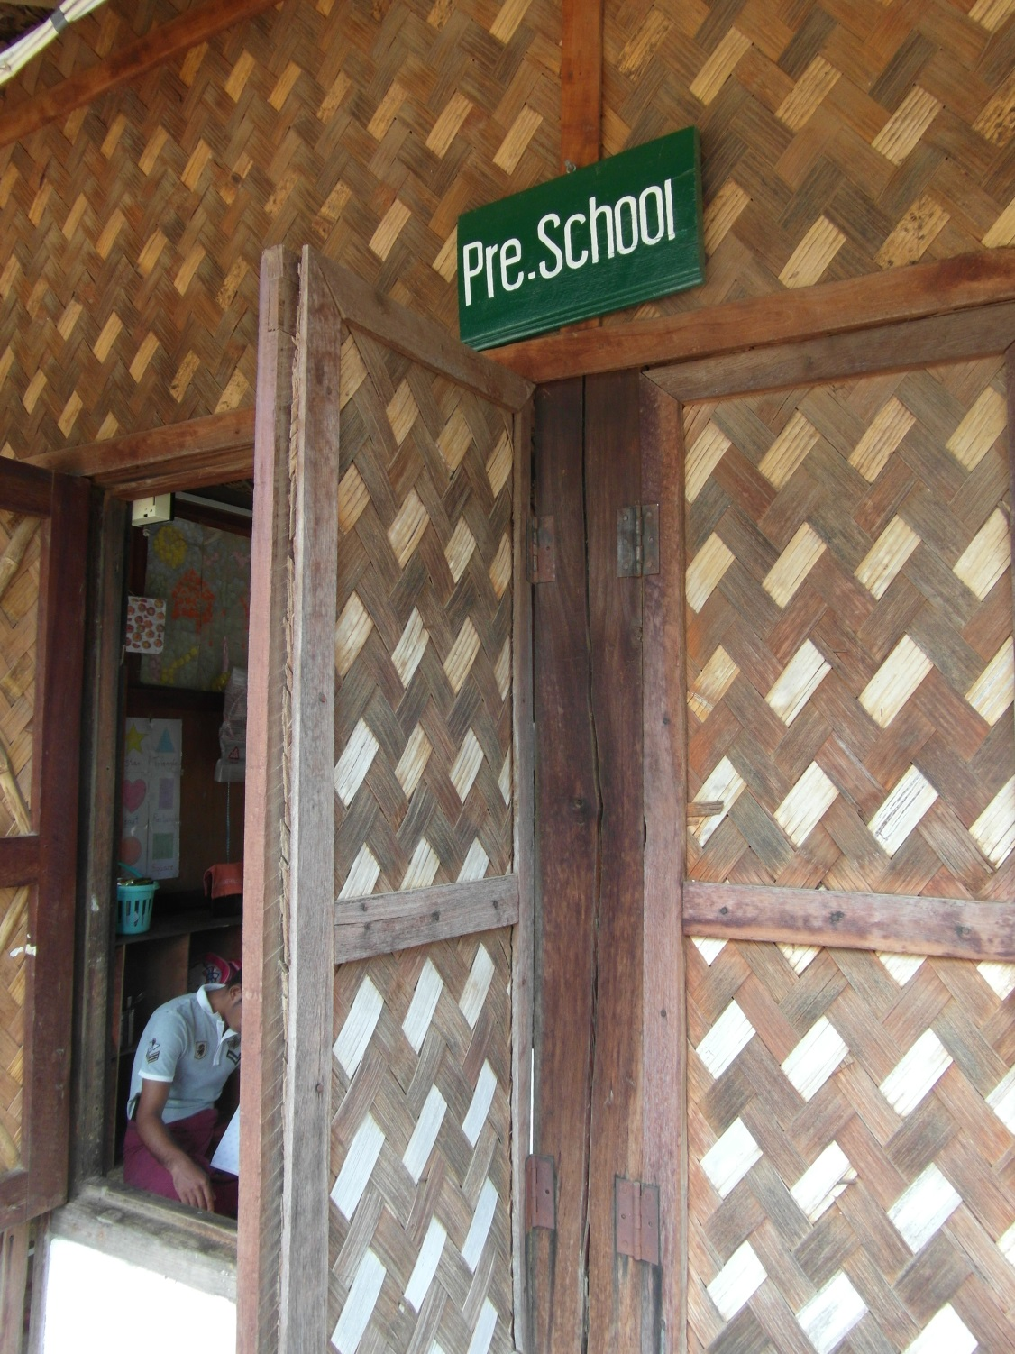
What’s behind that traditional door?

Slide 9
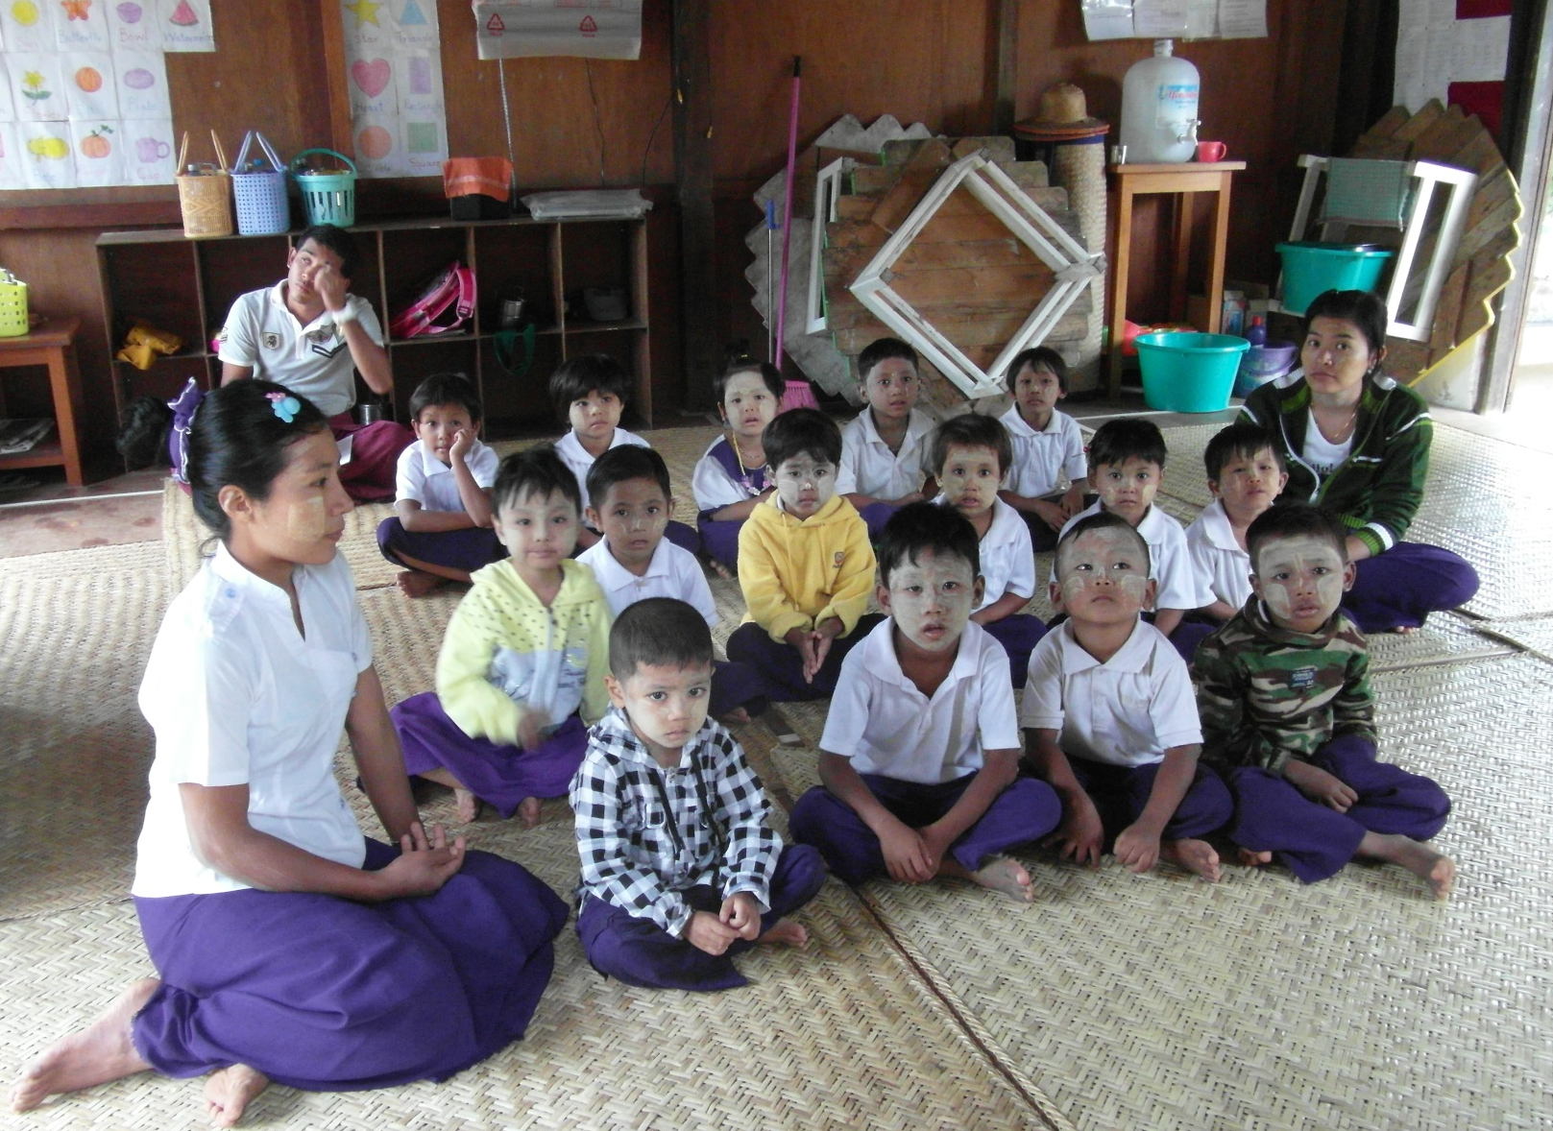
Pre-school

Slide 10
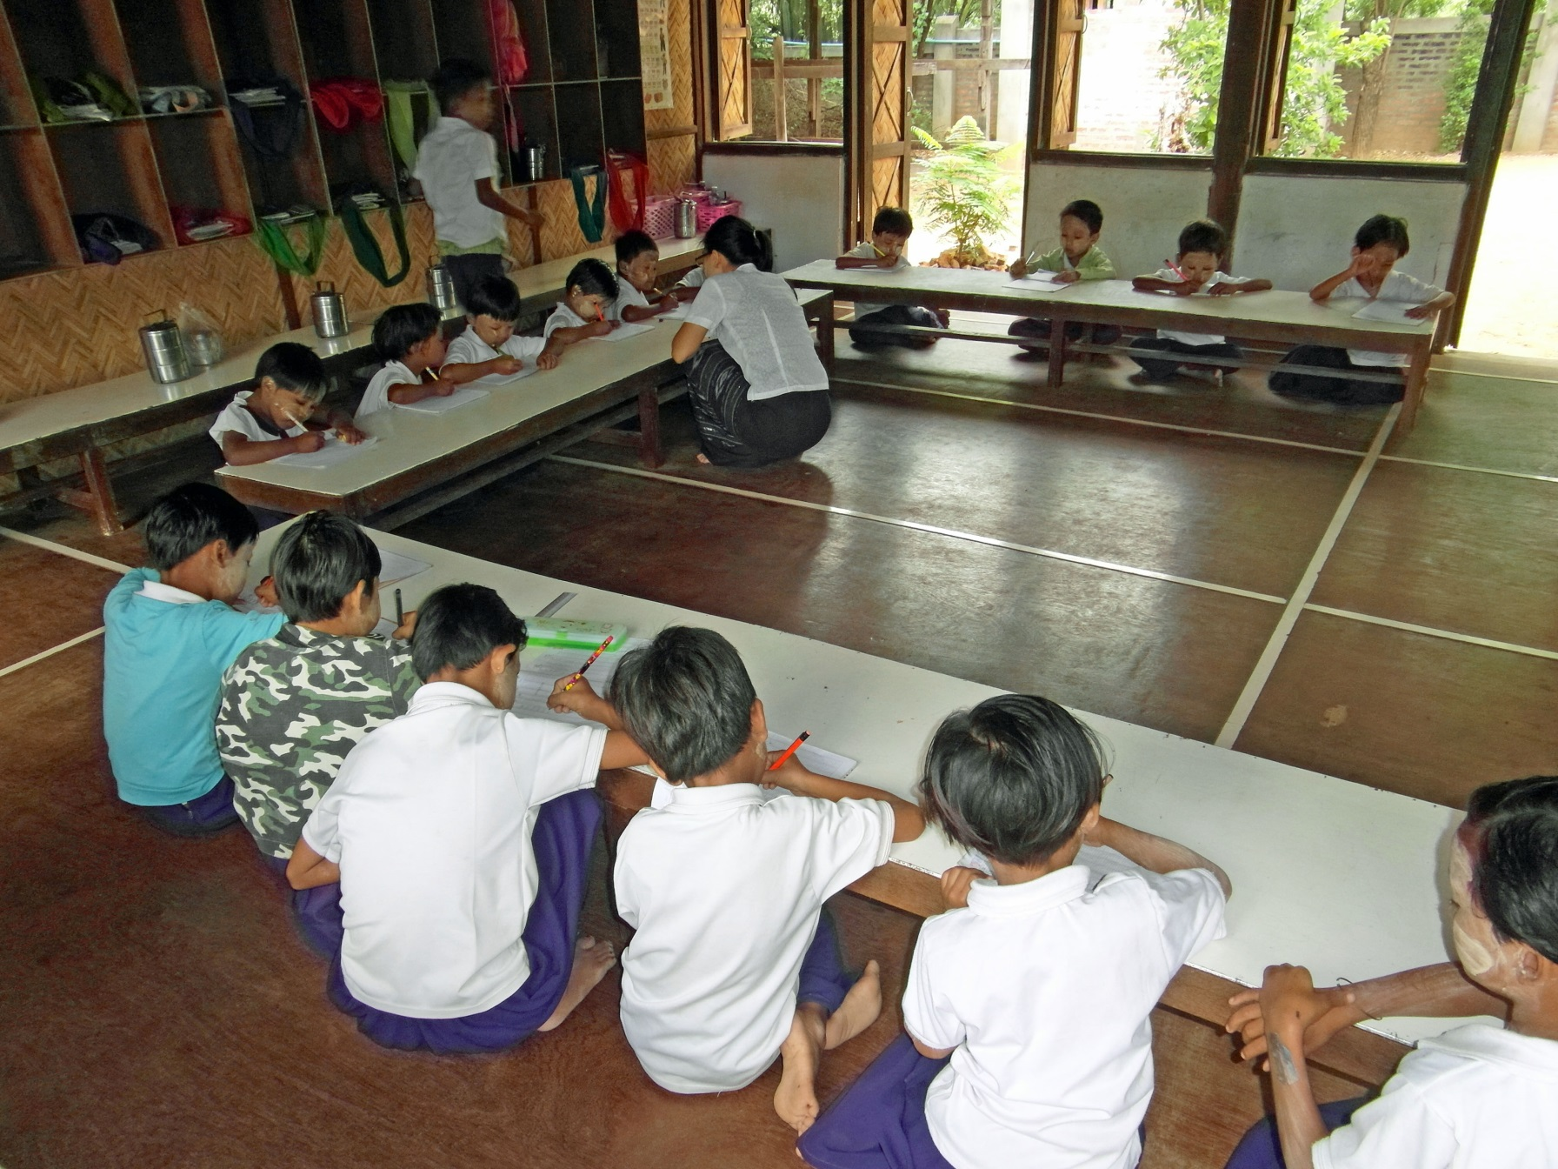
Low tables for grade 2

Slide 11
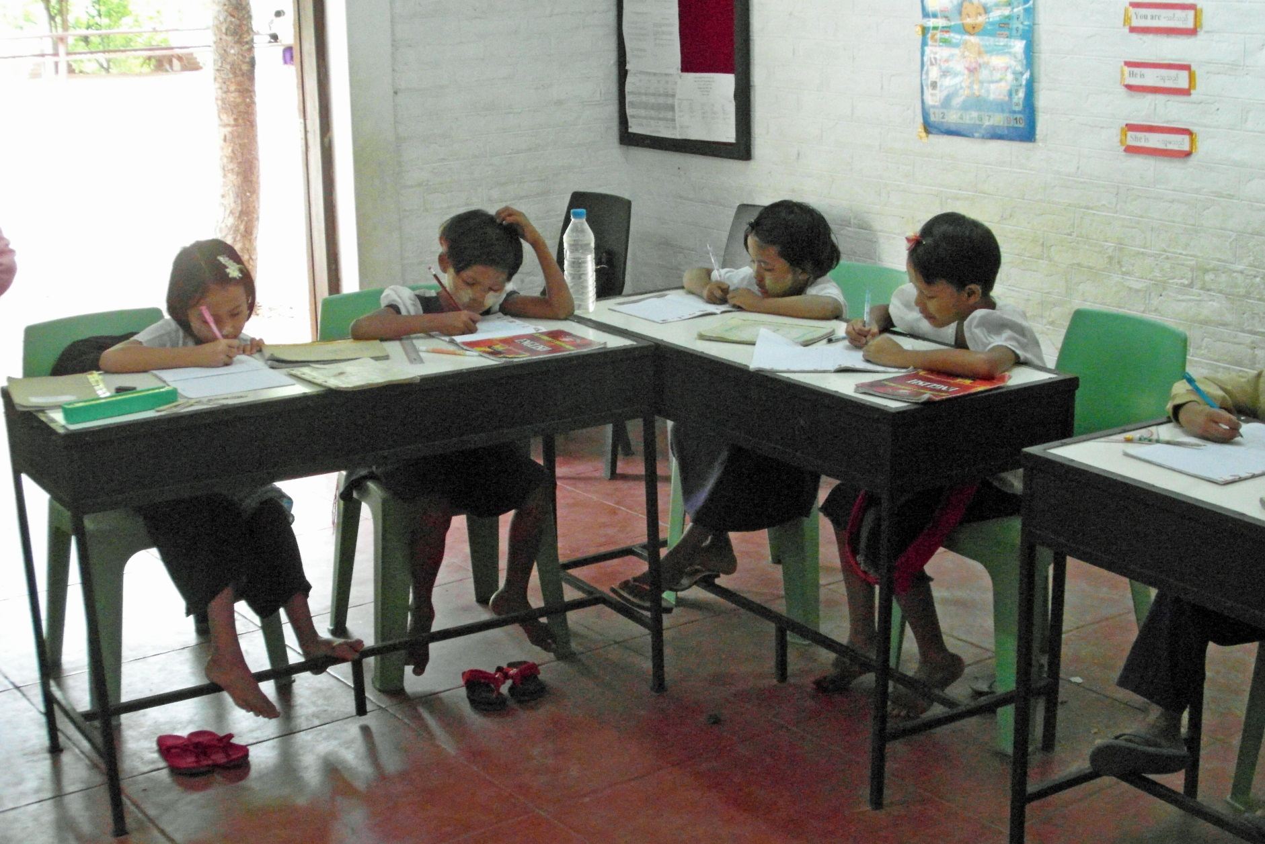
High tables for English grade 4

Slide 12
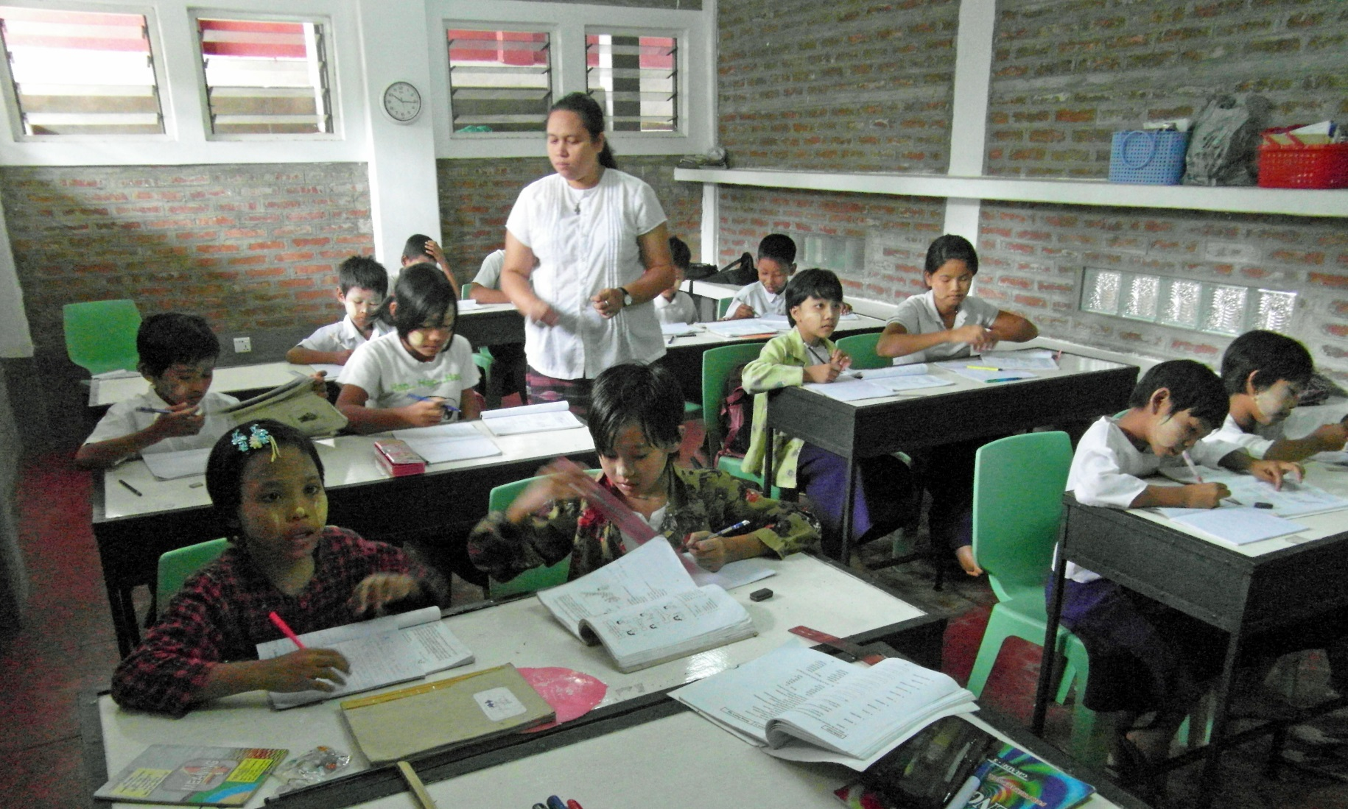
English Grade 6

Slide 13
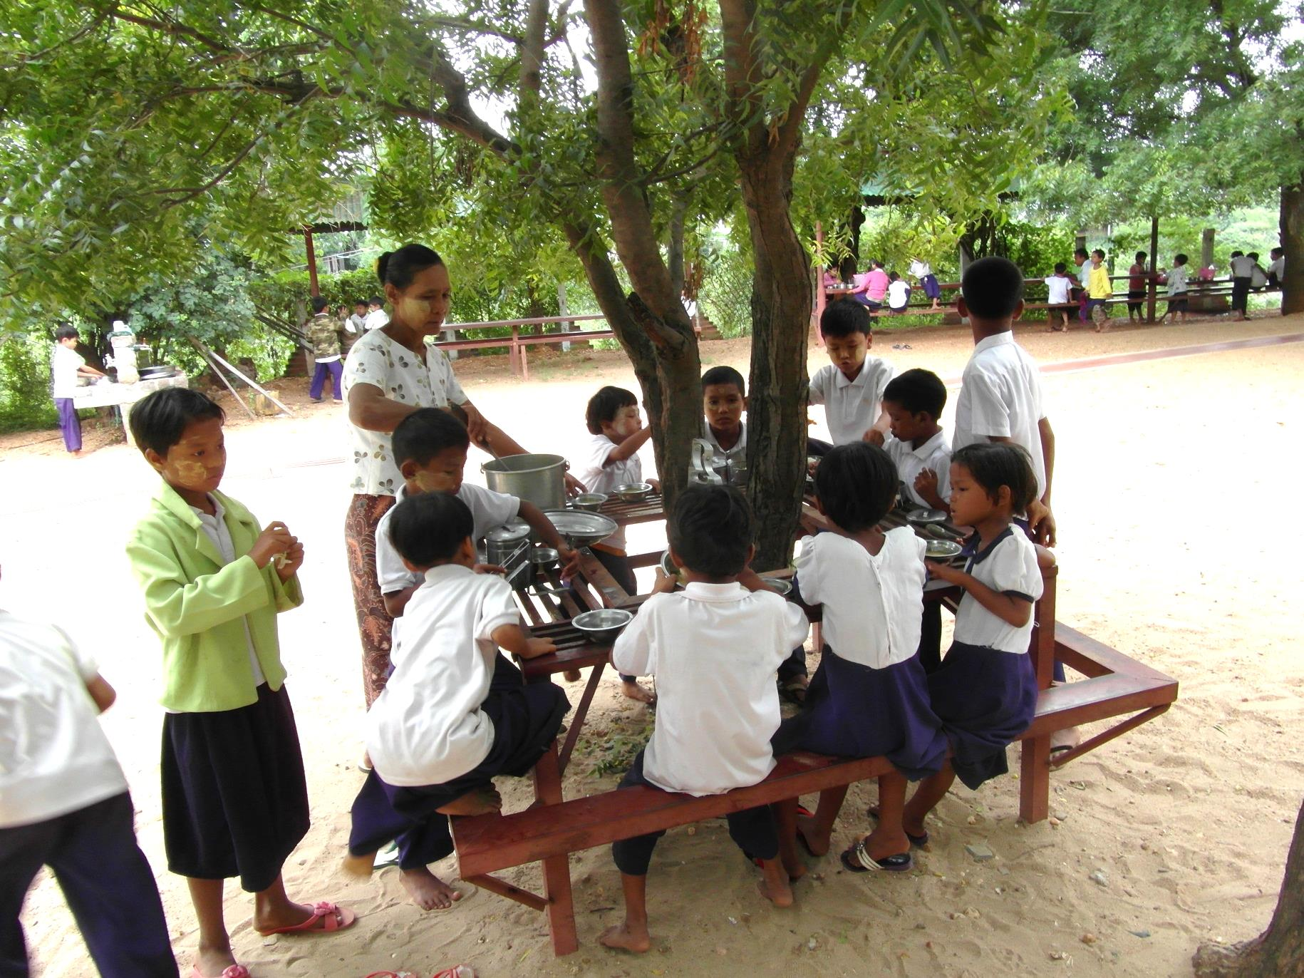
Lunch break

Slide 14
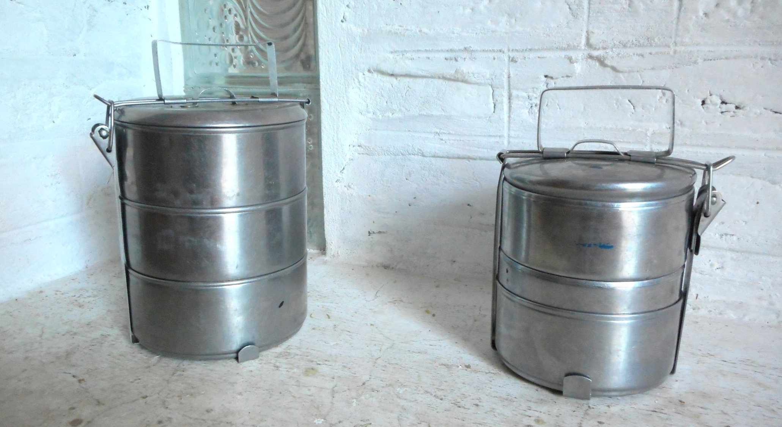
Lunch boxes

Slide 15
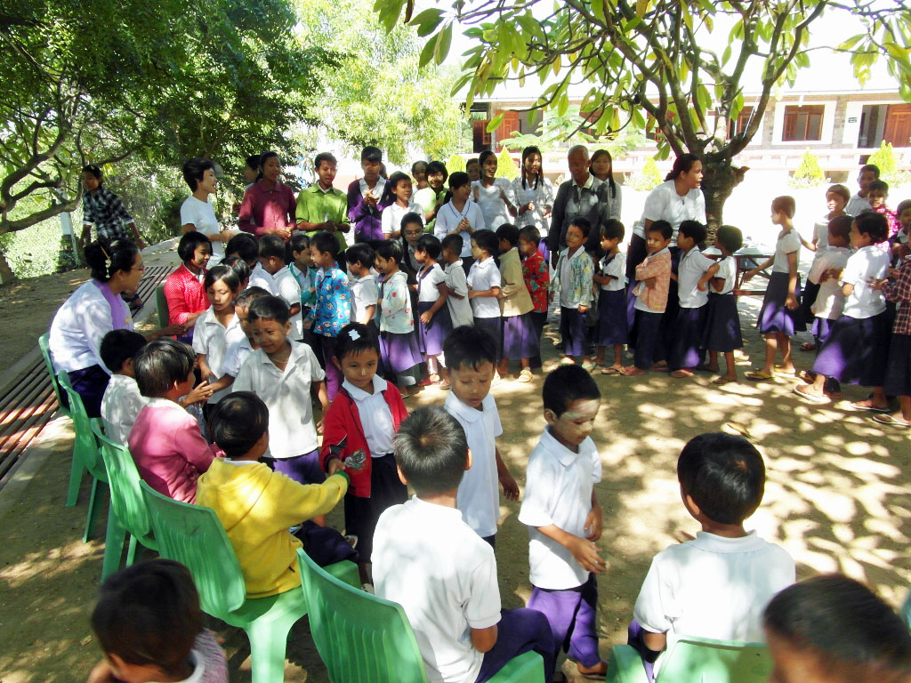
Birthday parade …

Slide 16
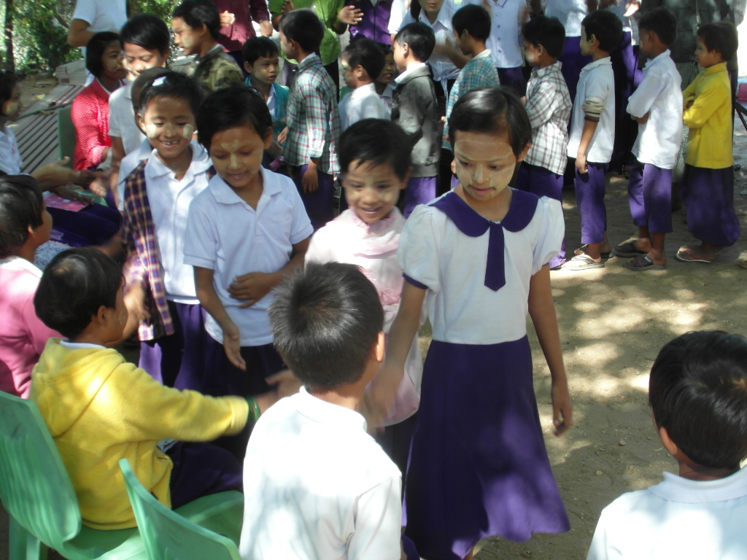
Happy birthday to you!

Slide 17
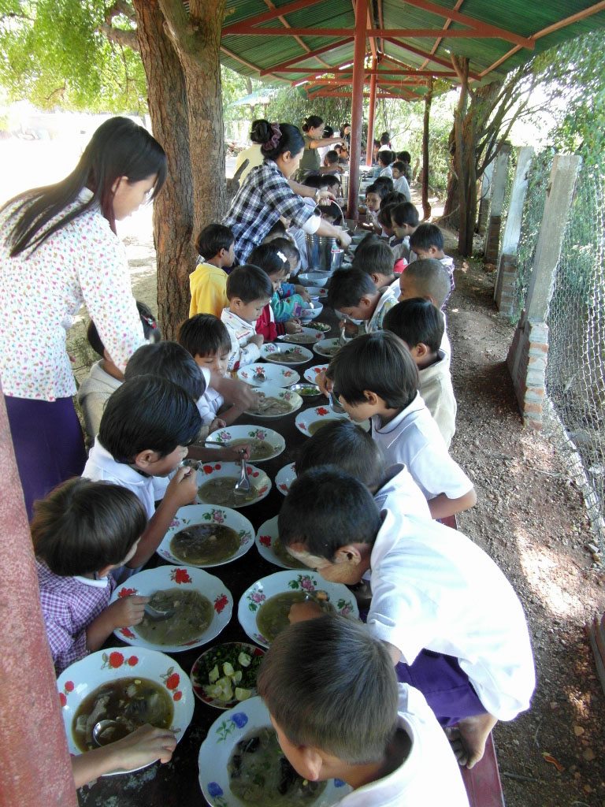
… with noodle soup.

Slide 18
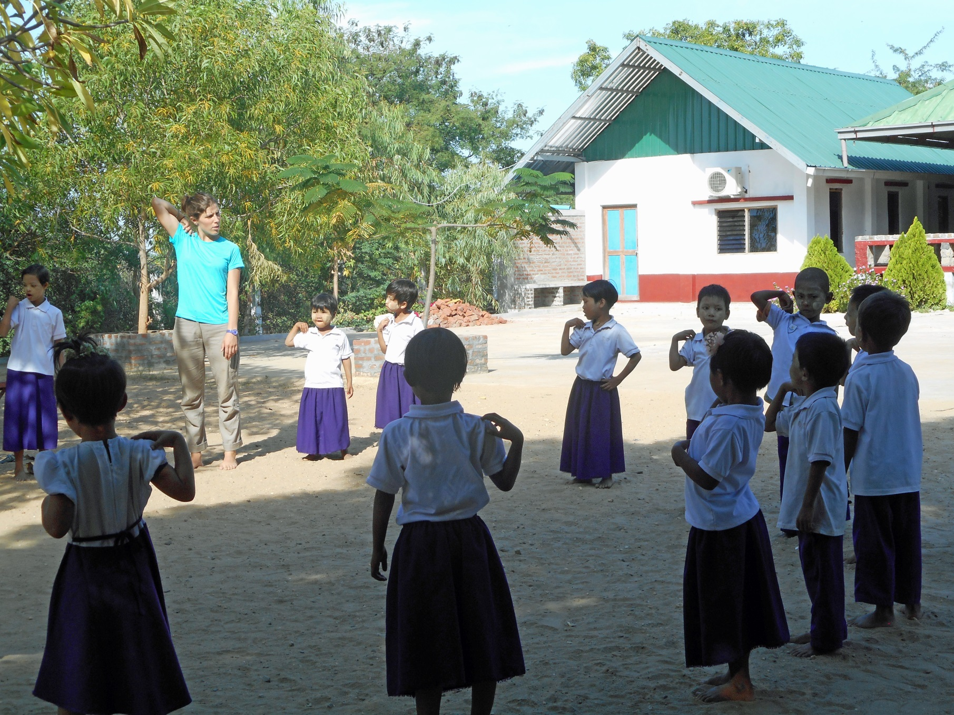
Sophie’s gymnastic lessons

Slide 19
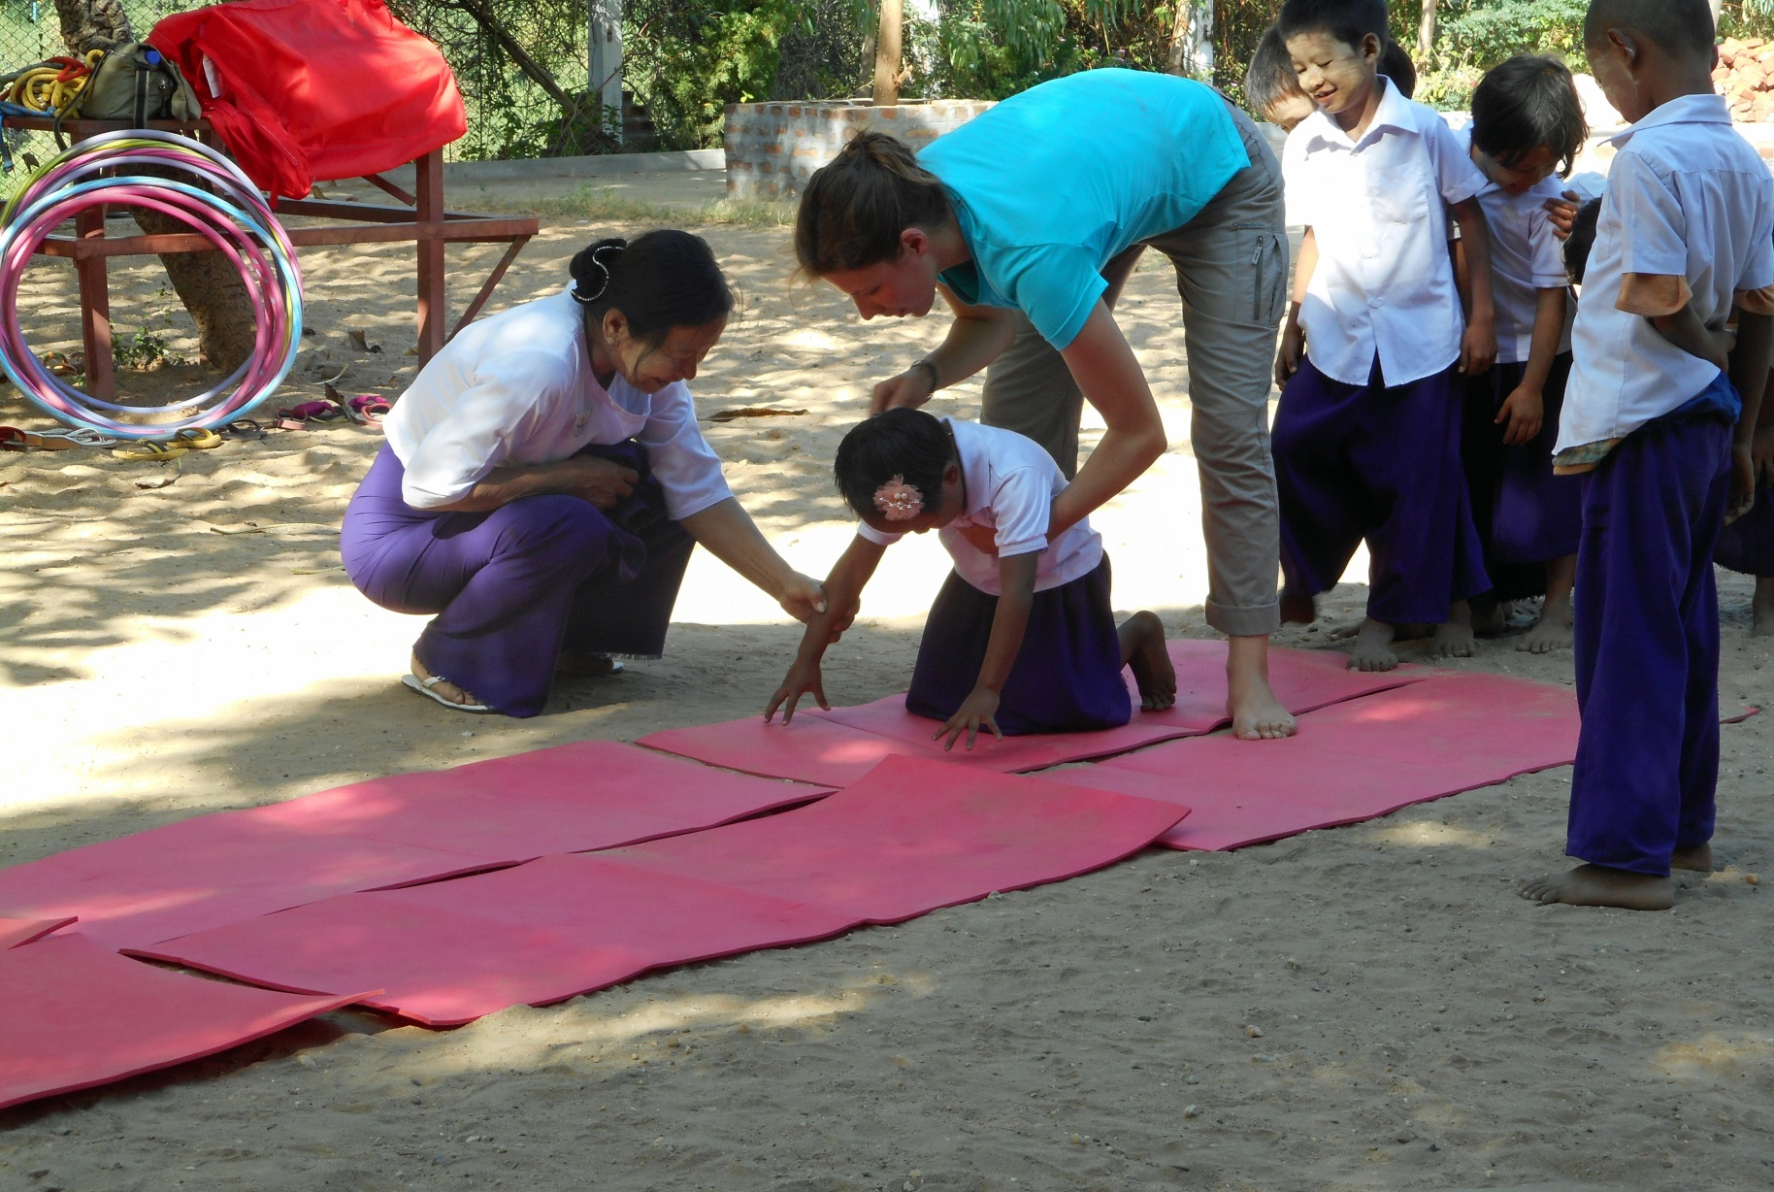
Summersault – not so easy!

Slide 20
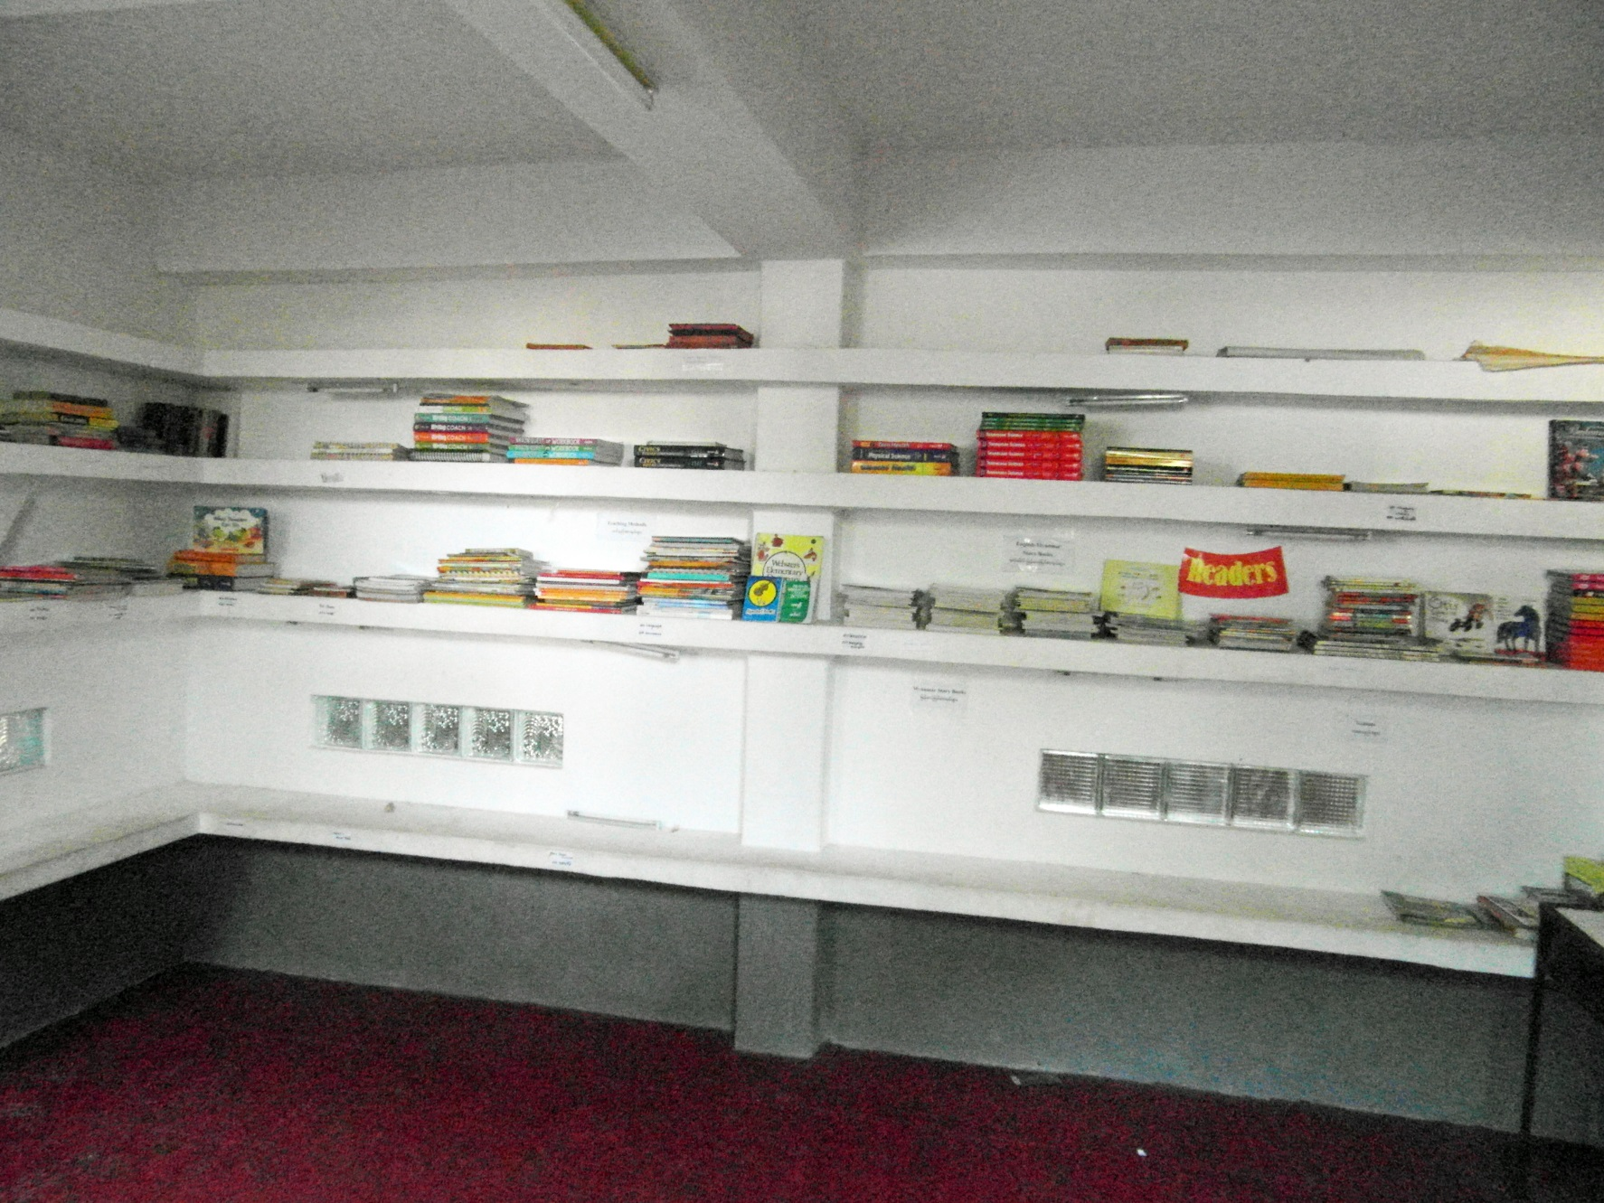
The re-organized library

Slide 21
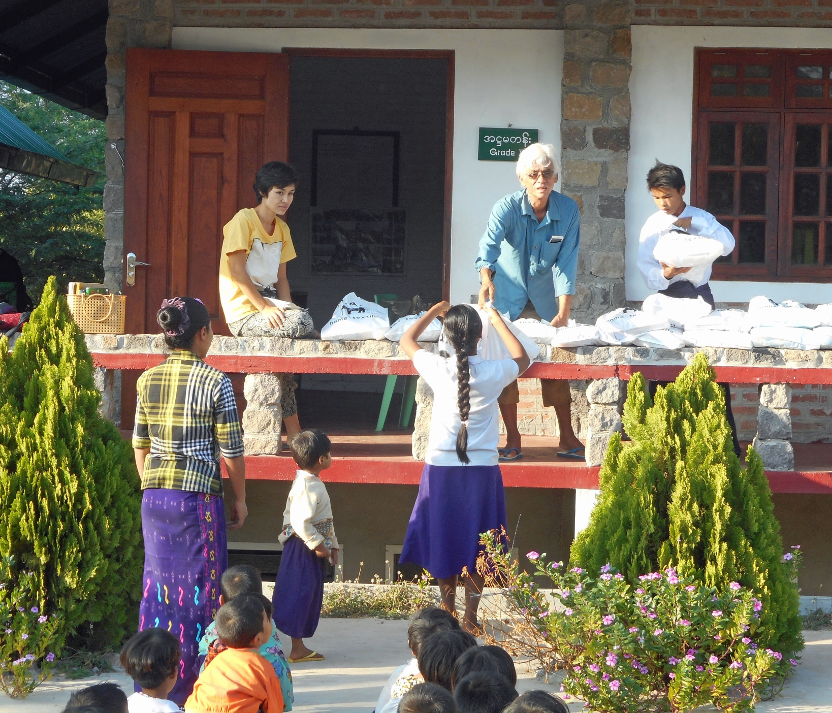
Winter is approaching - gift of blankets

Slide 22
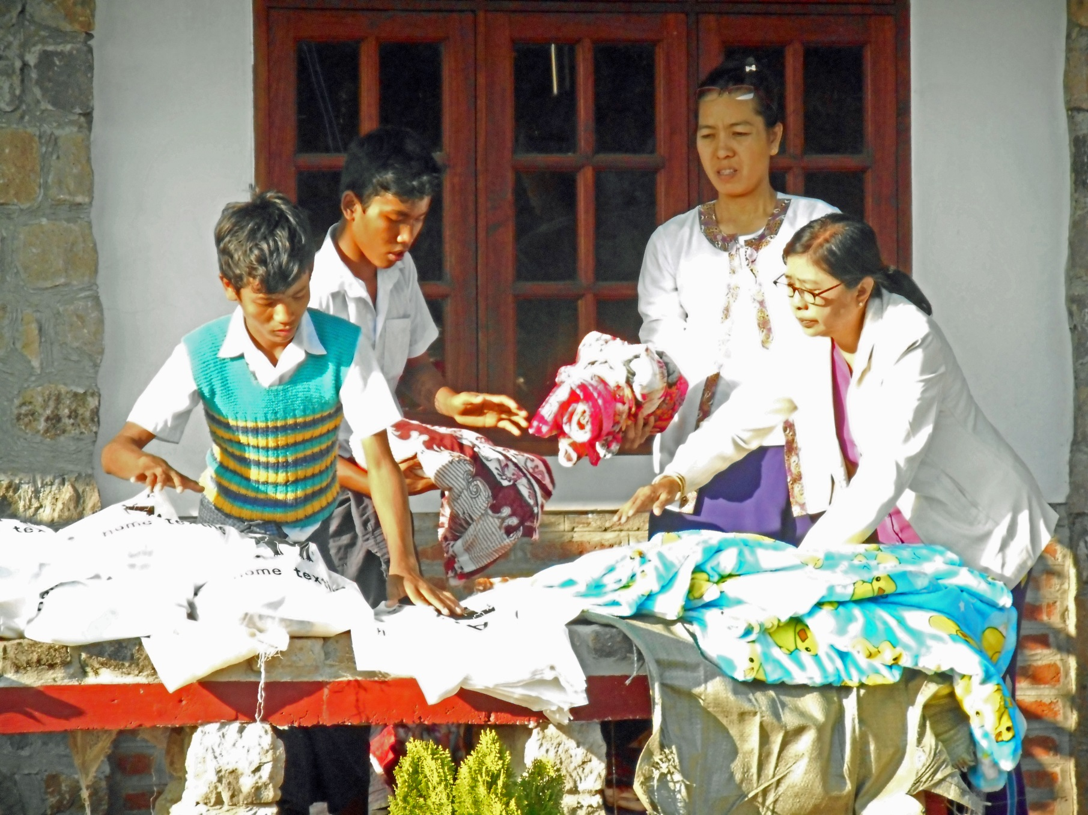
Packing blankets

Slide 23
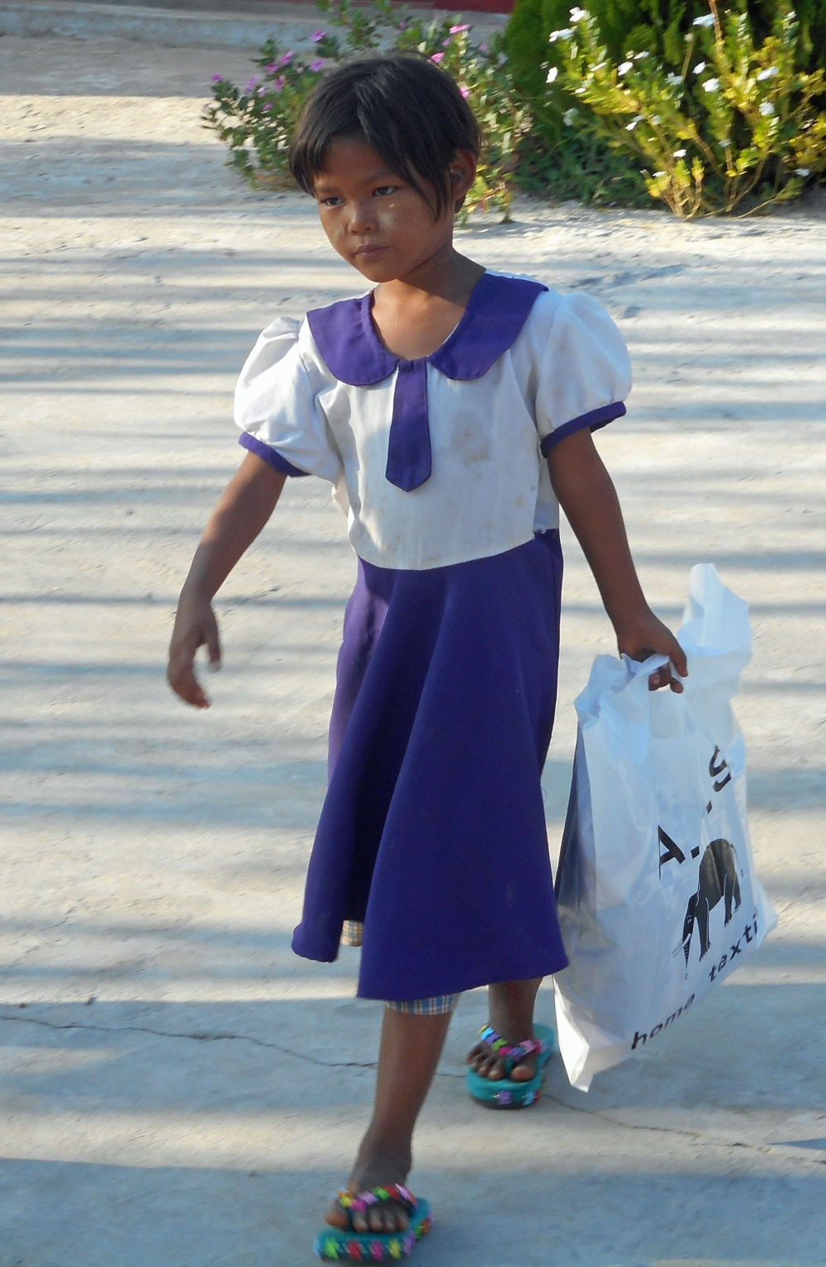
Proud to carry the blanket home!

Slide 24
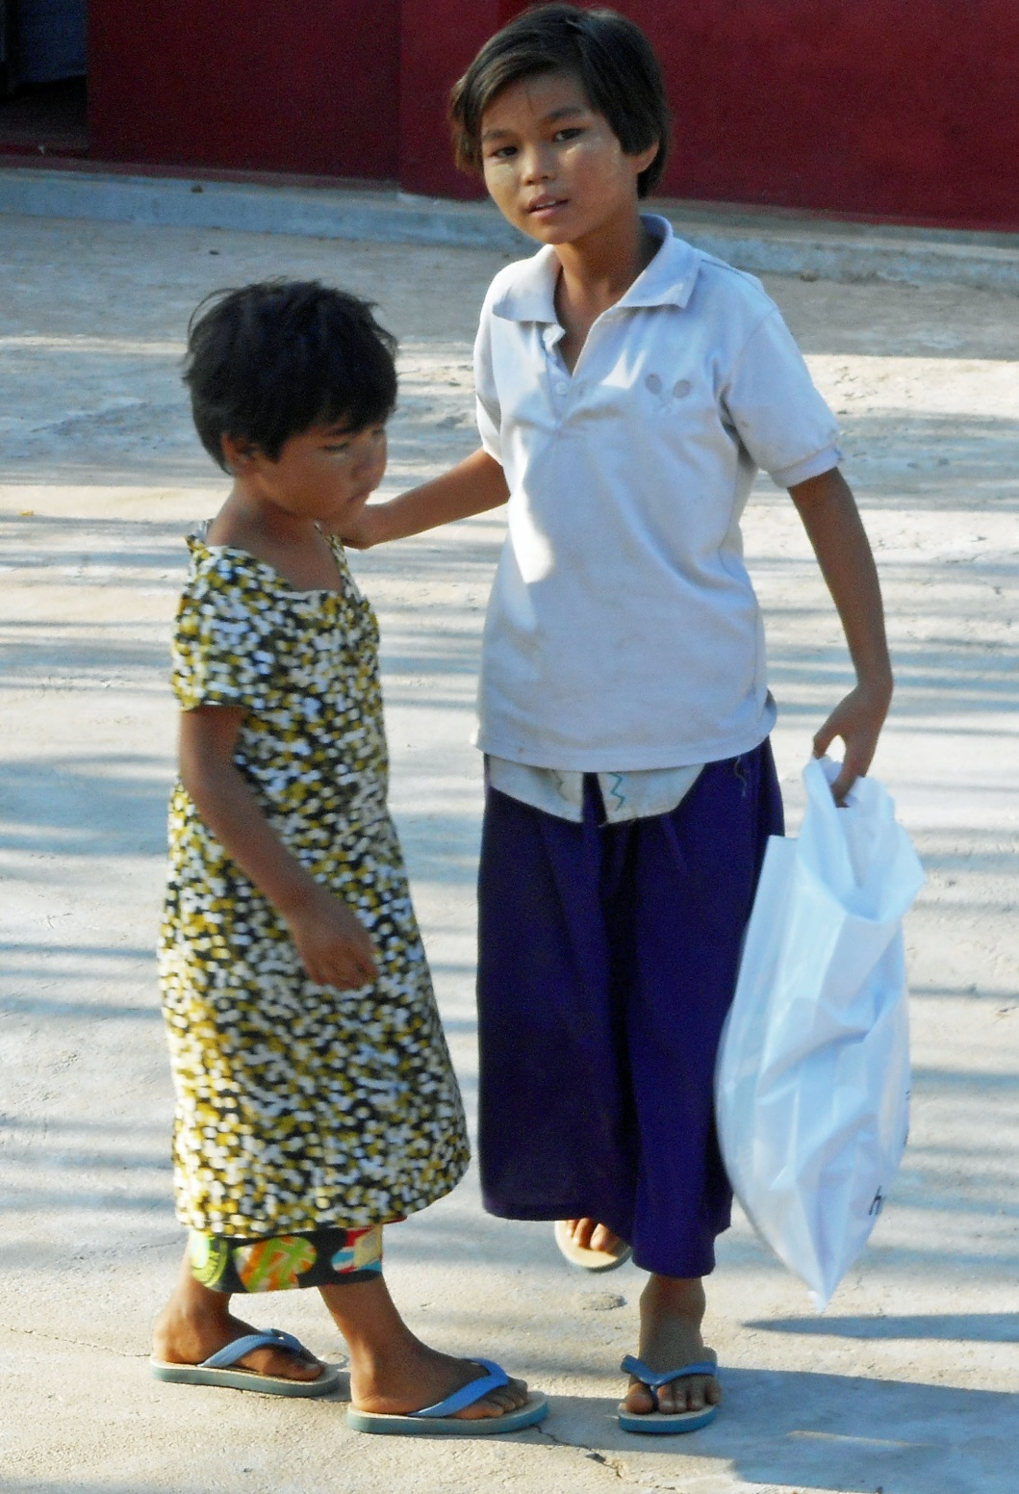
Yes, there is one for you in the bag!

Slide 25
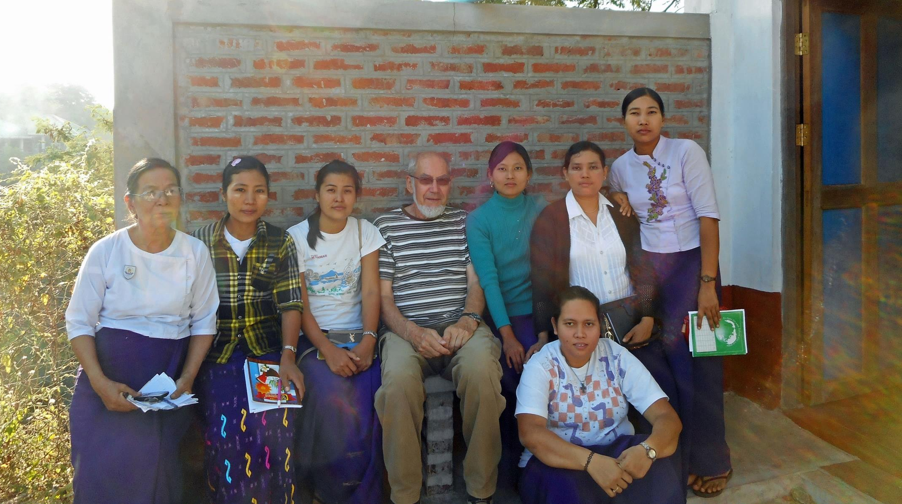
The teachers

Slide 26
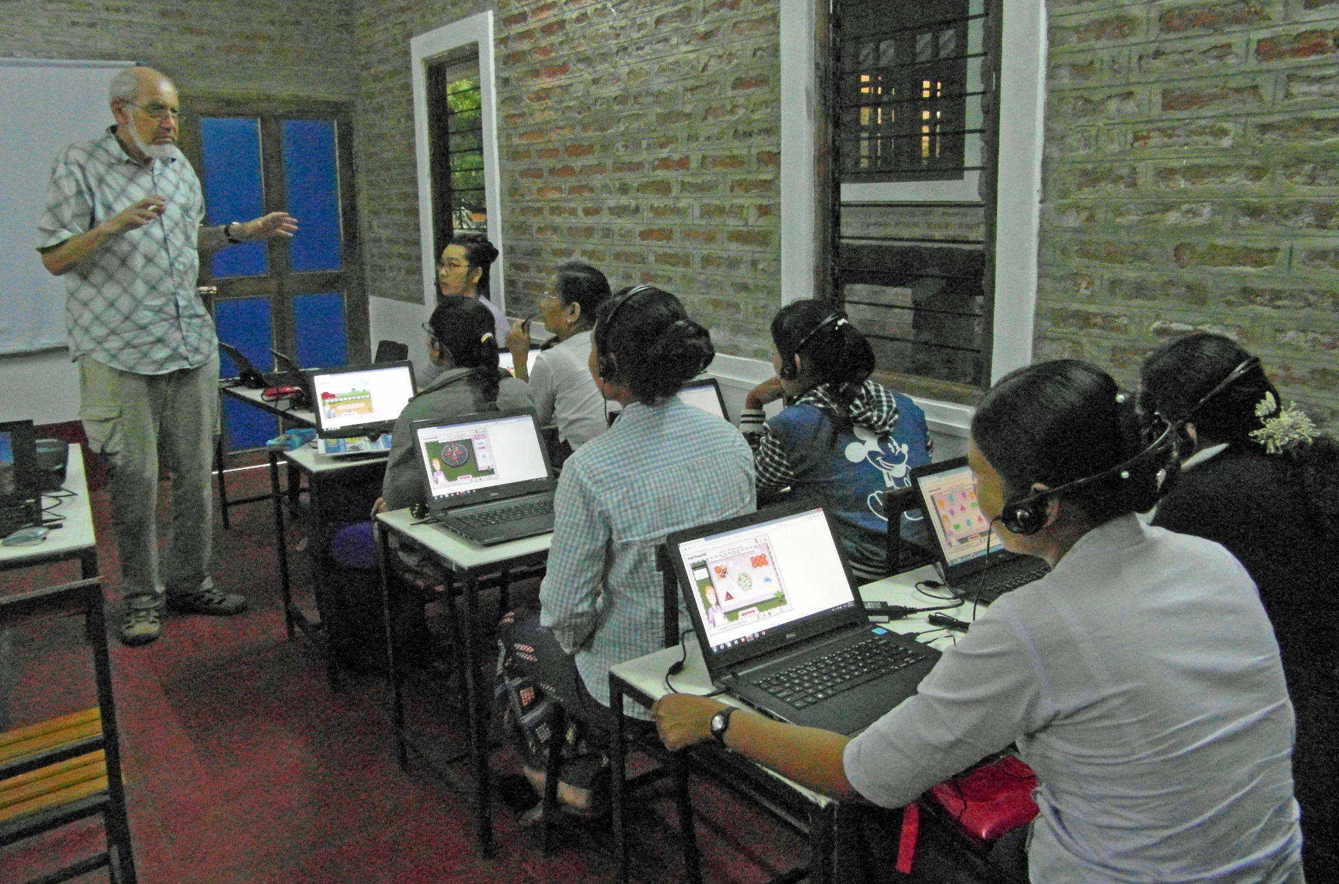
A computer lesson for the teachers

Slide 27
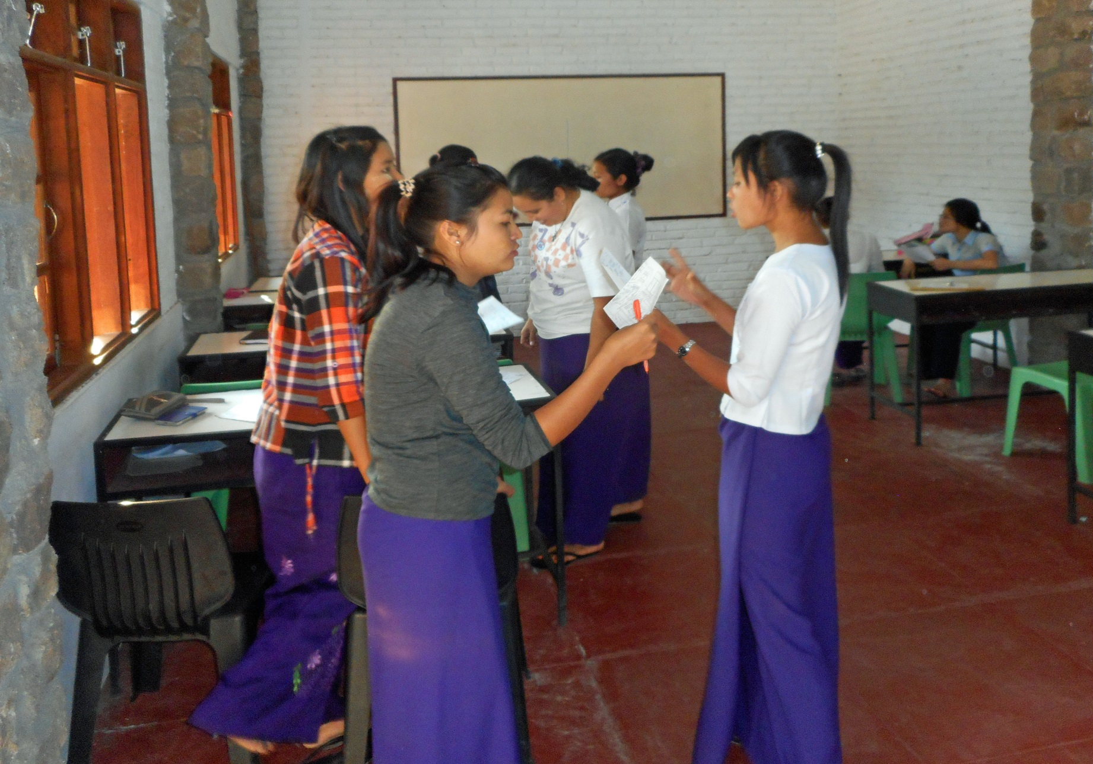
Teachers’ pairwork in English

Slide 28
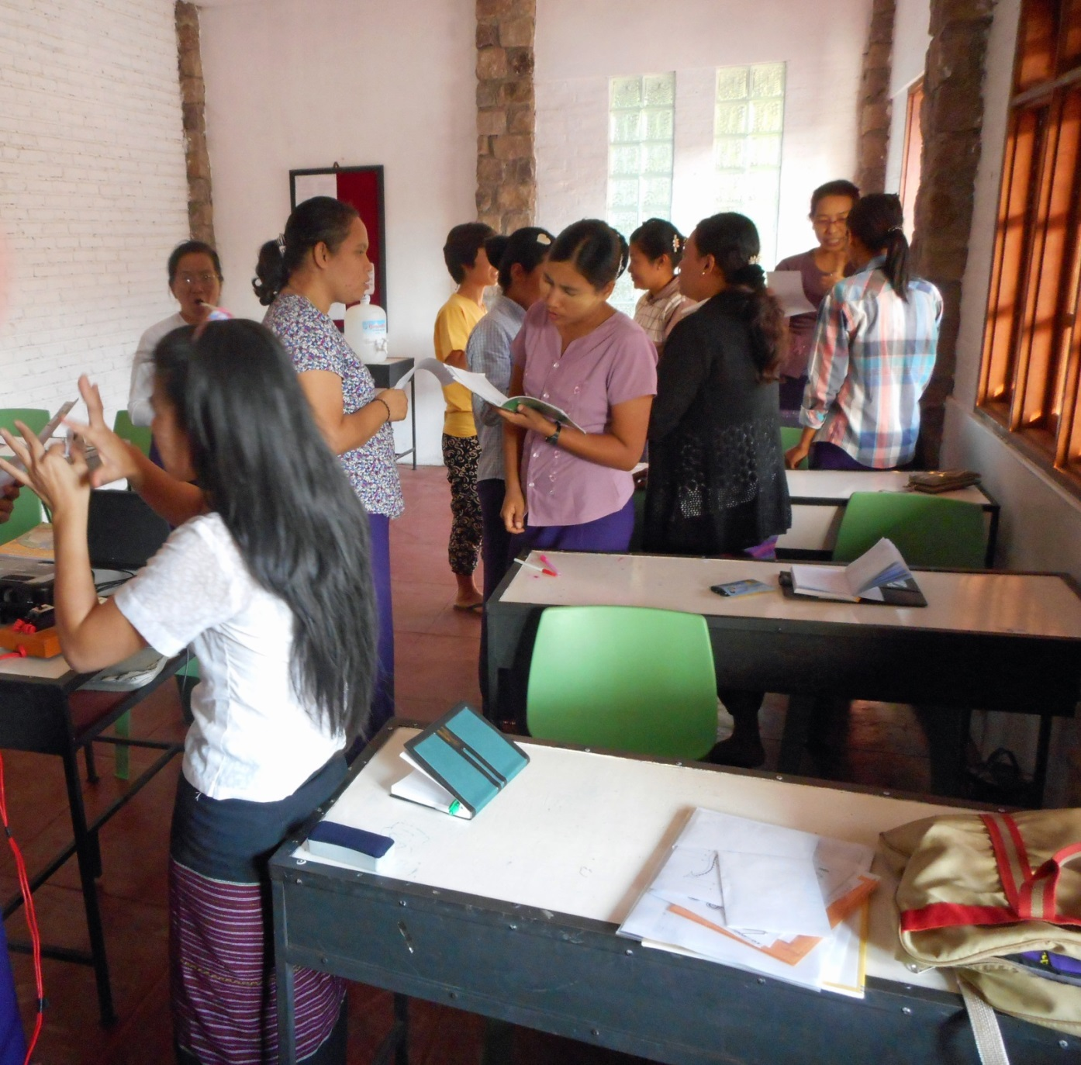
It’s becoming animated!

Slide 29
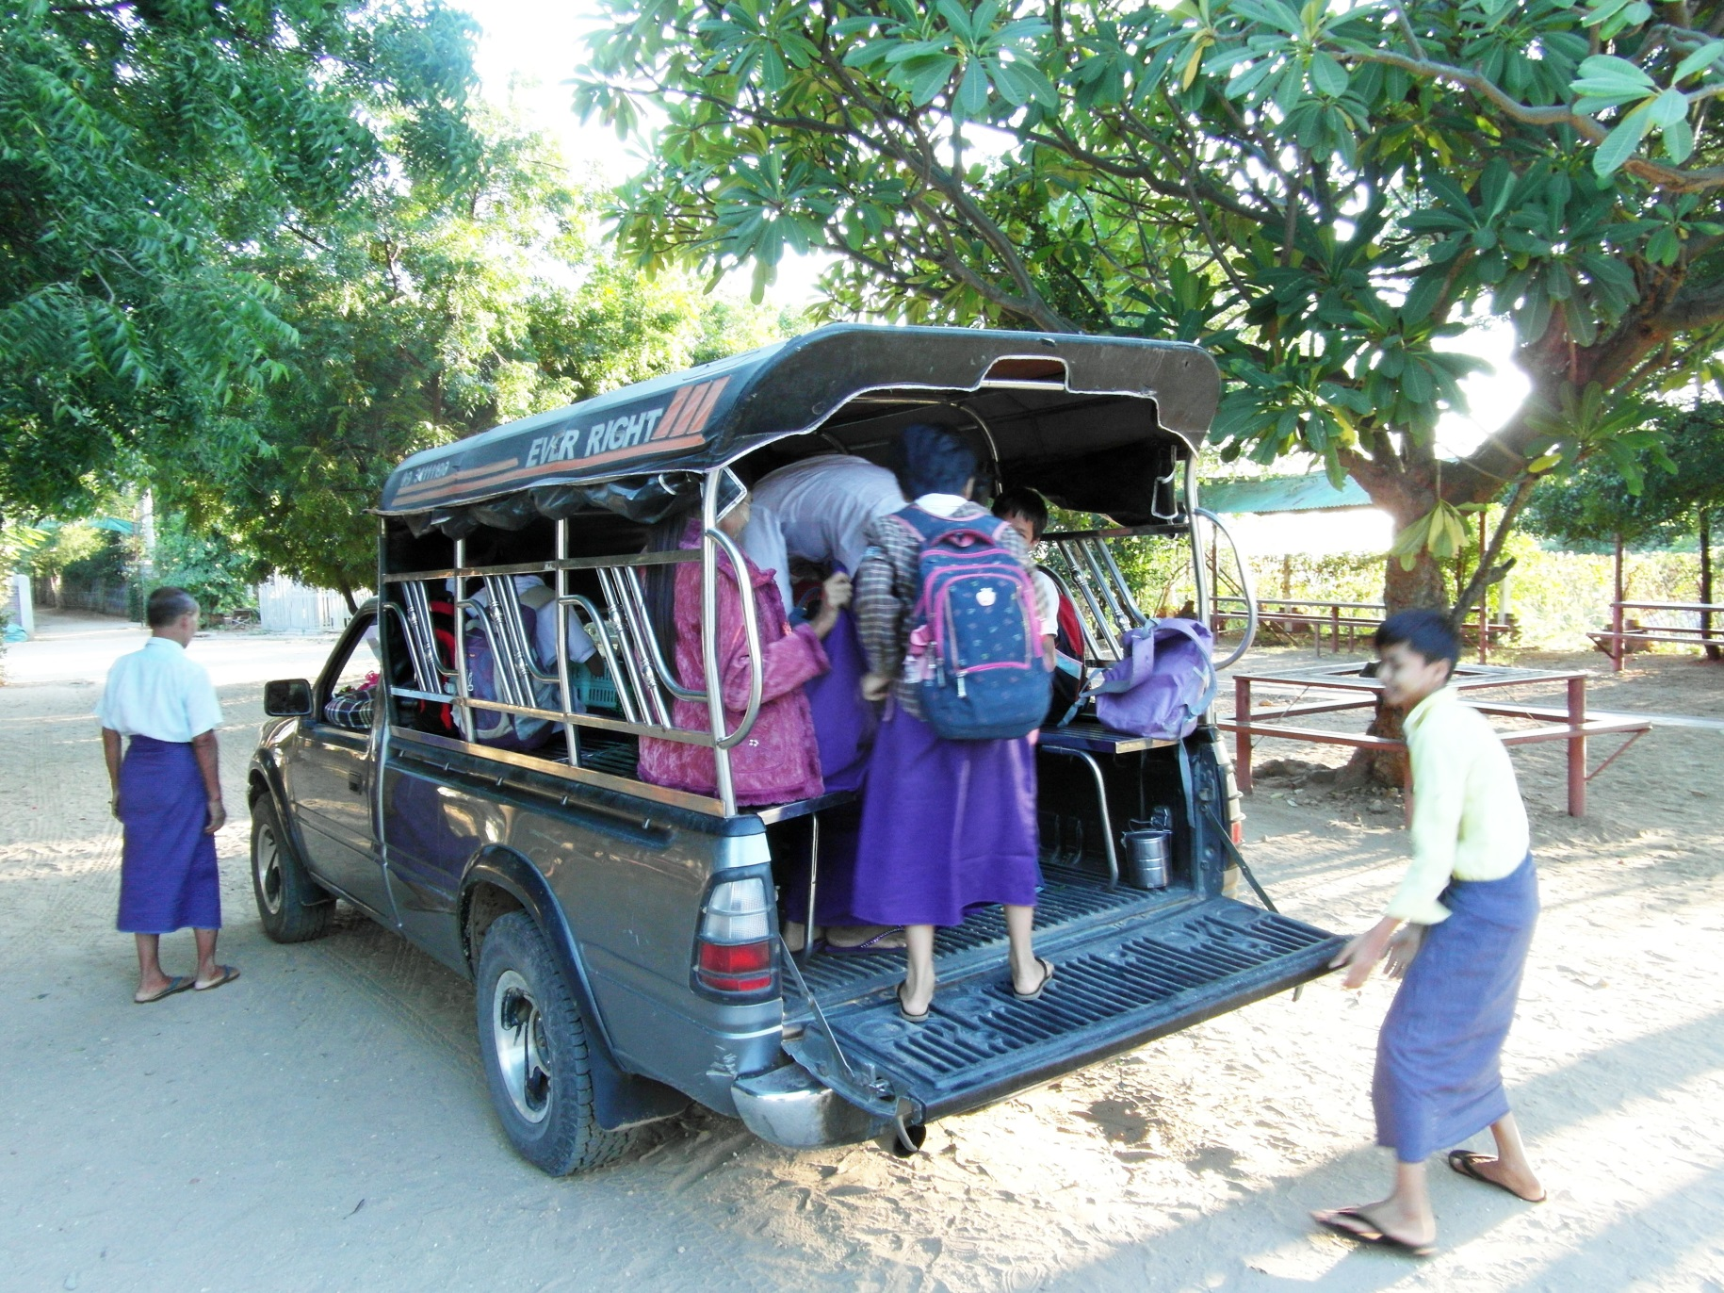
Yes, yes, there is some space left!

Slide 30
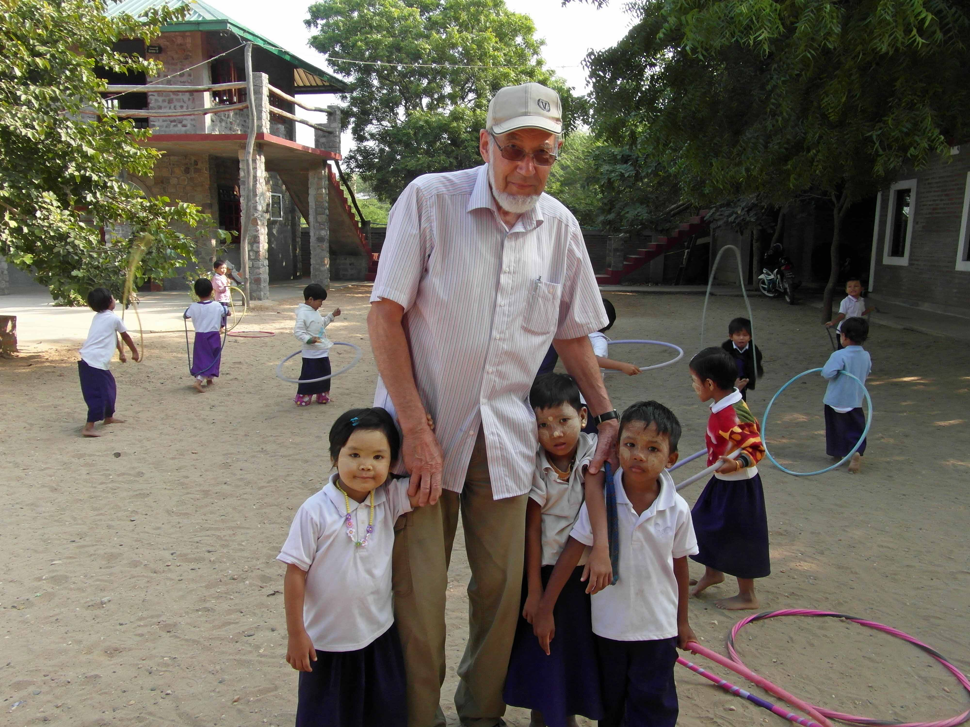
Goodbye after 6 weeks

Slide 31
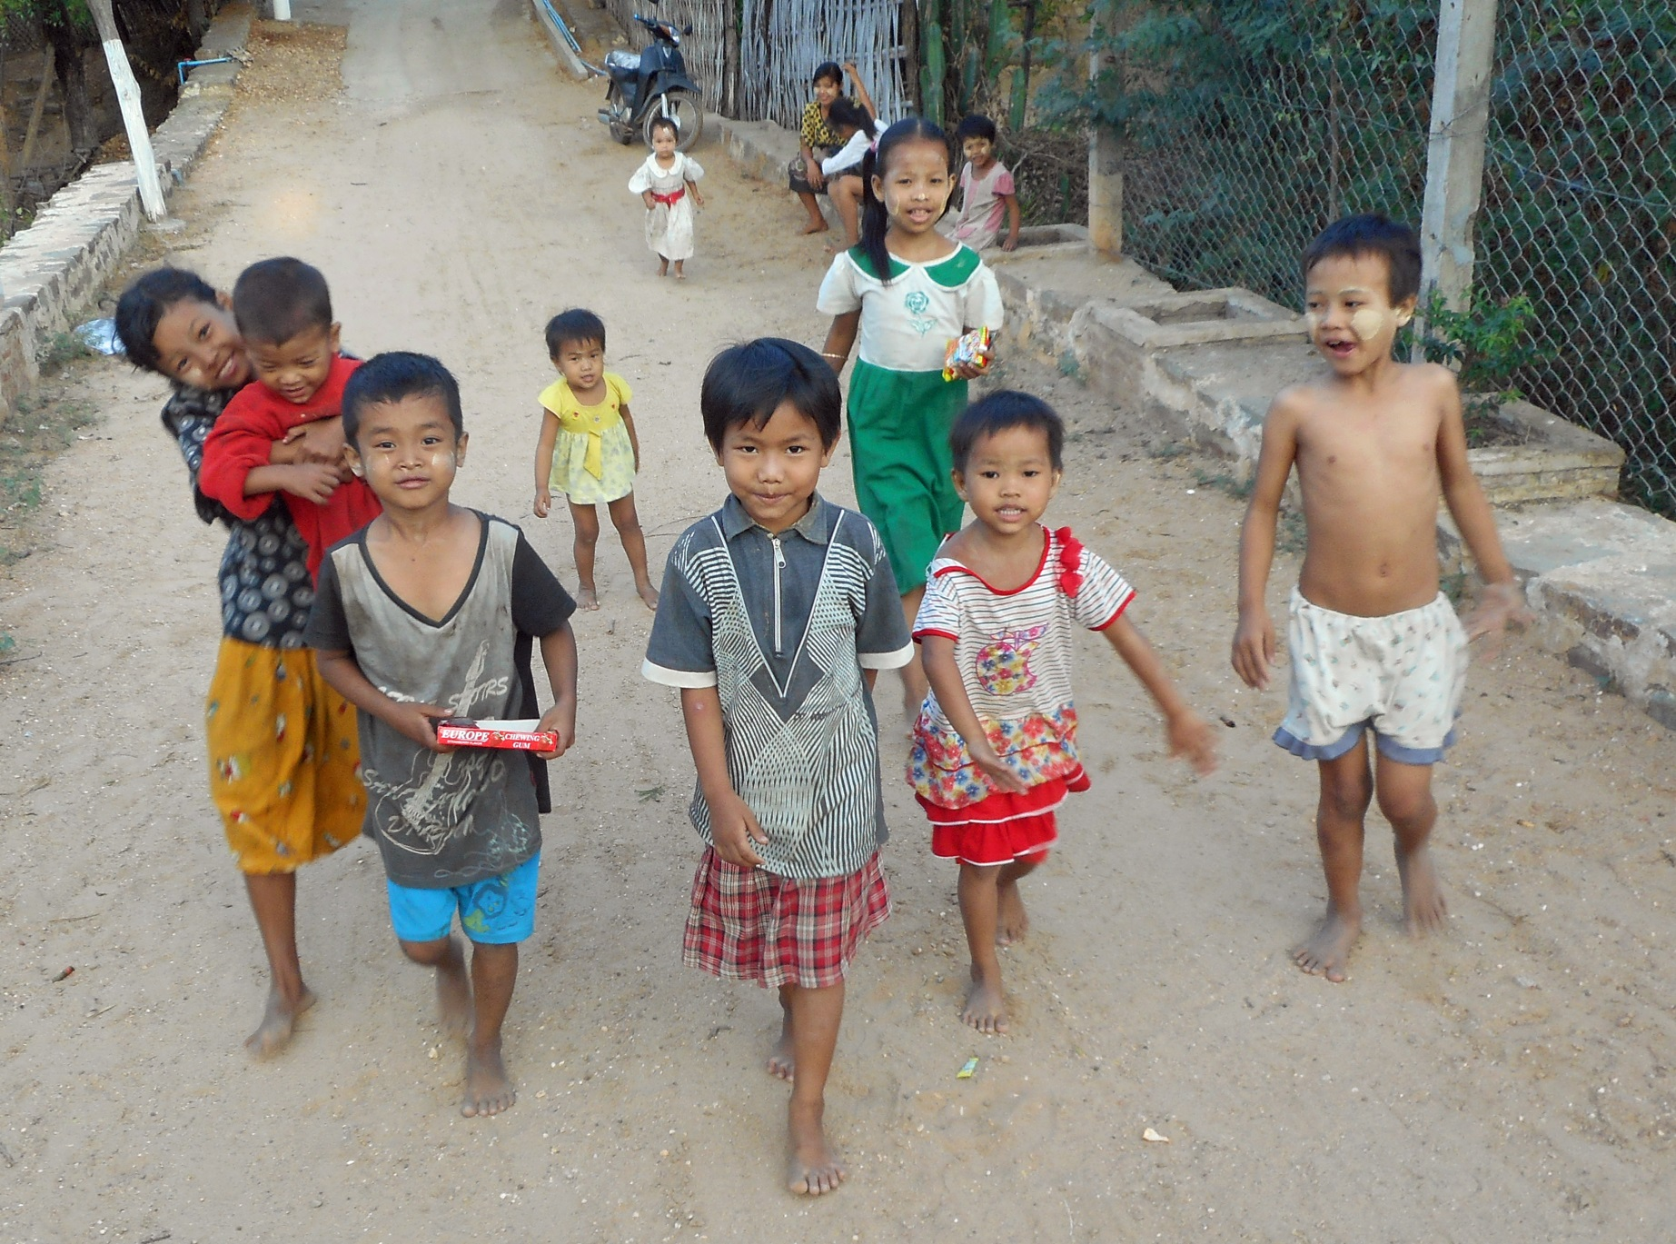
Future students??

Slide 32
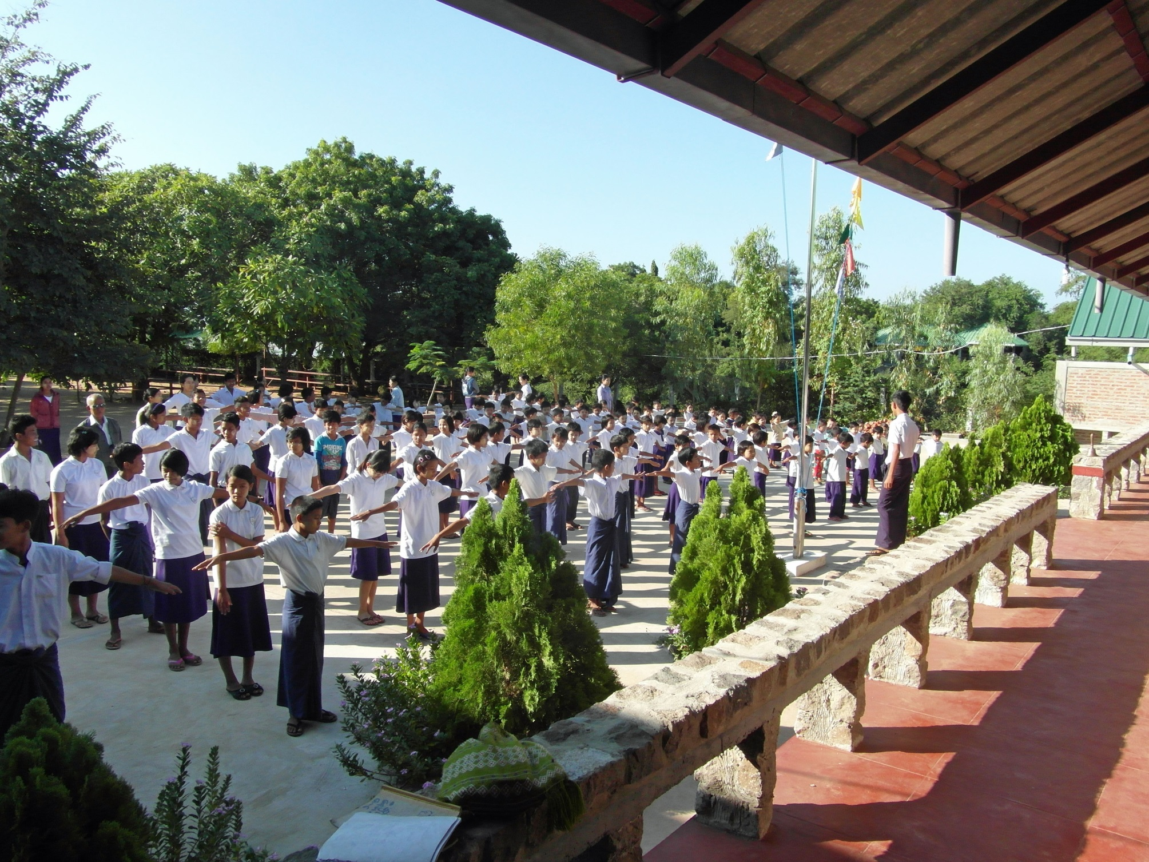
The end

