Slide 1
Saturday, 21 November 2015 Motorbike tour to Sale

Slide 2
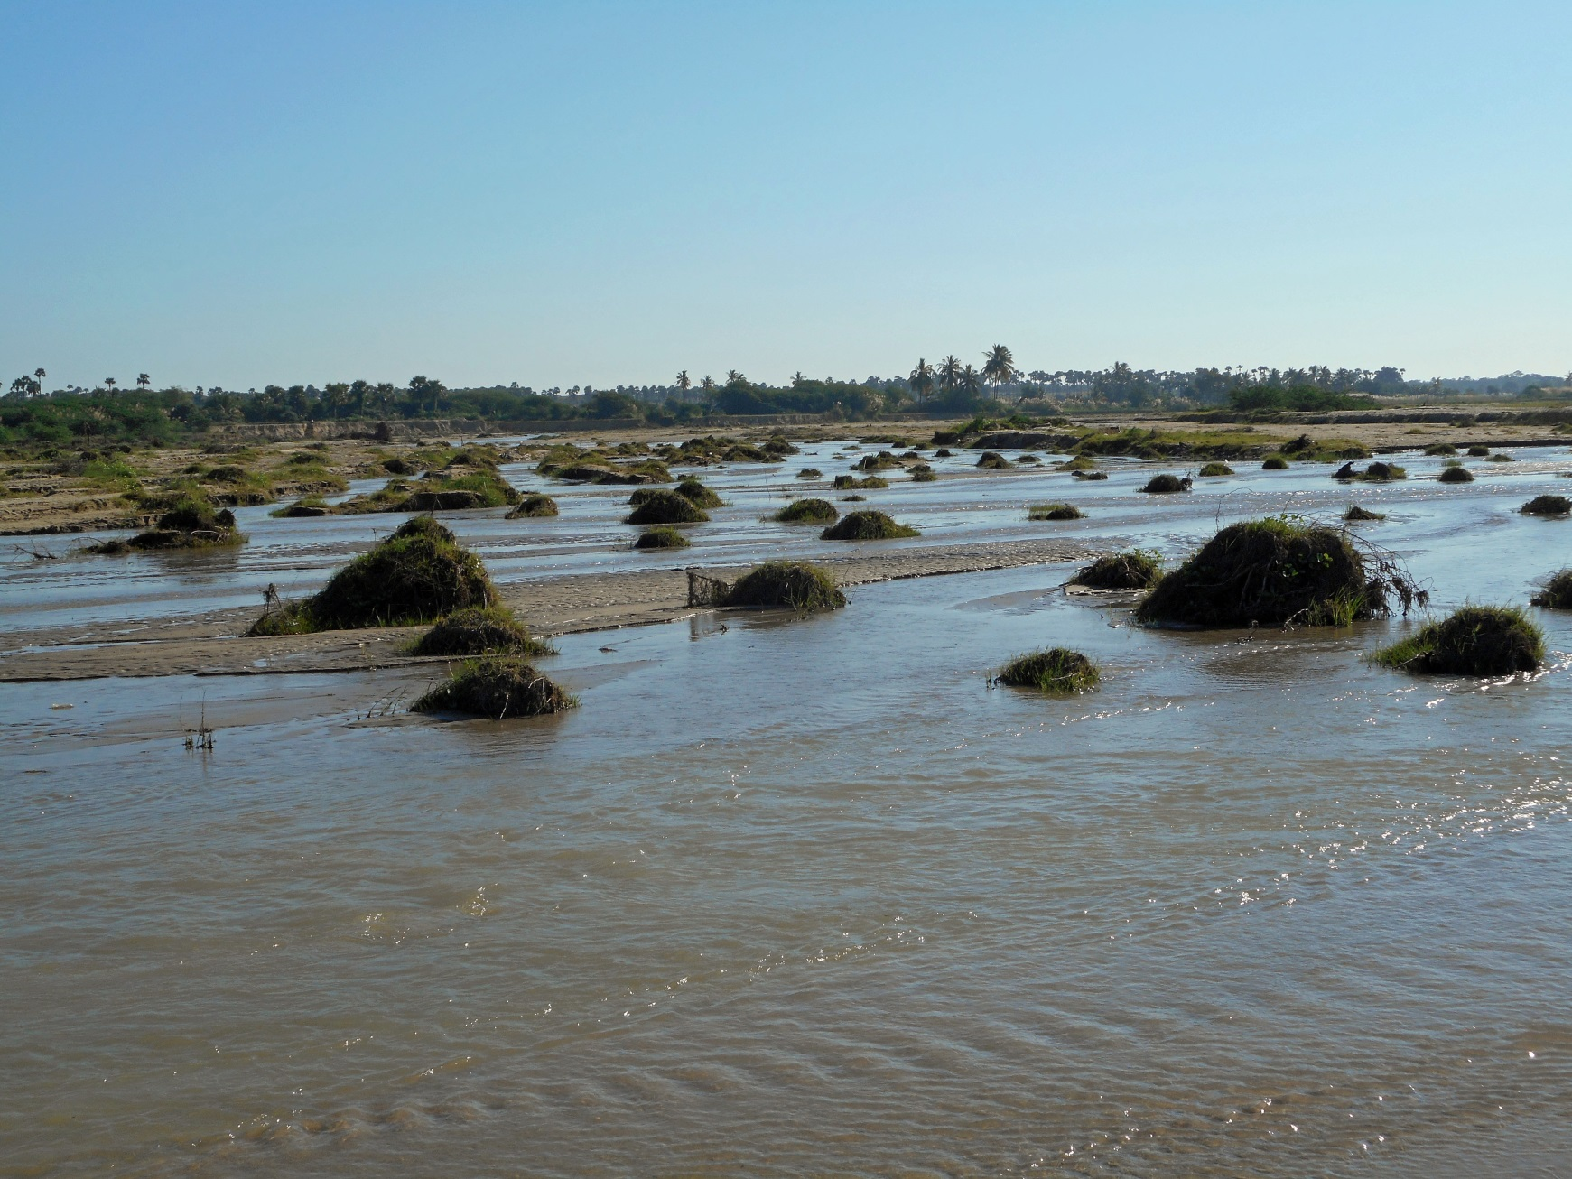
How are we getting across?

Slide 3
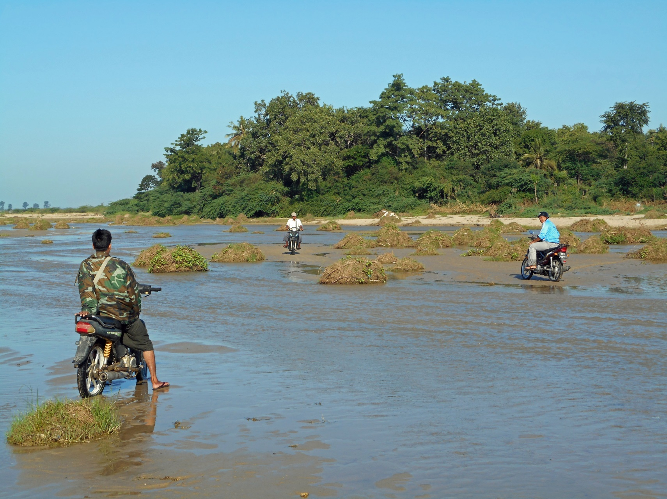
.
No problem – with wet feet!

Slide 4
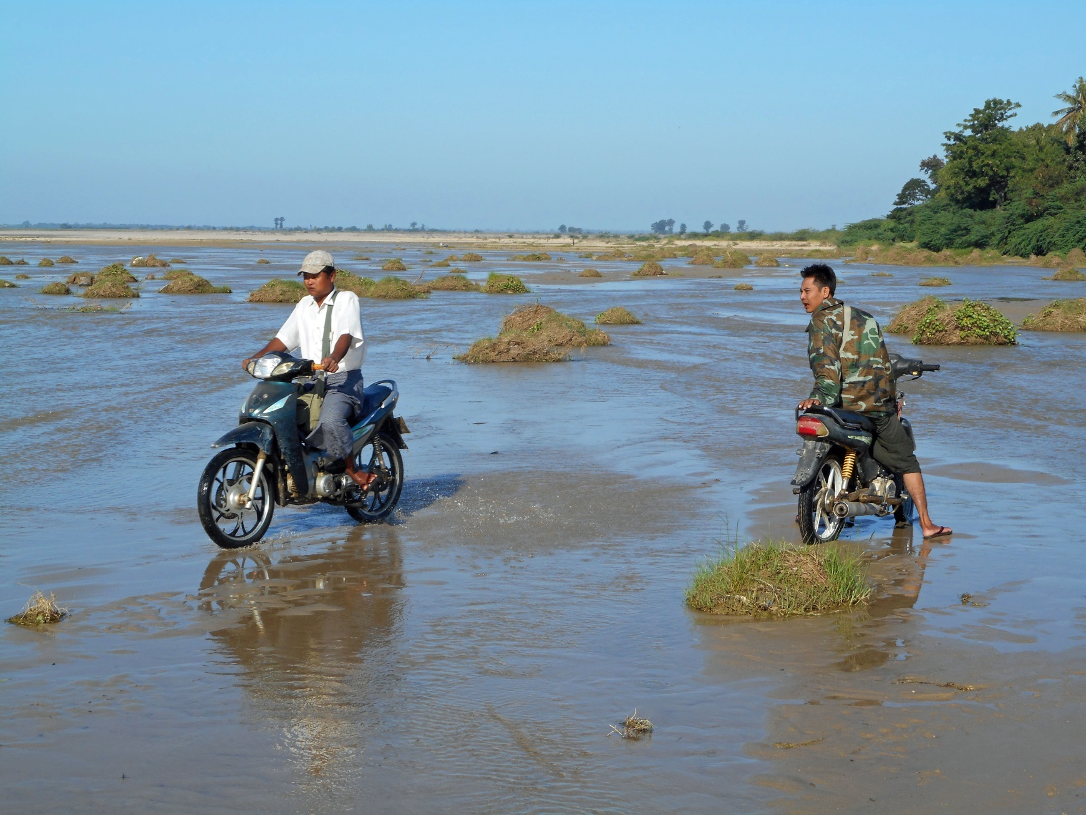
The passengers have to dismount.

Slide 5
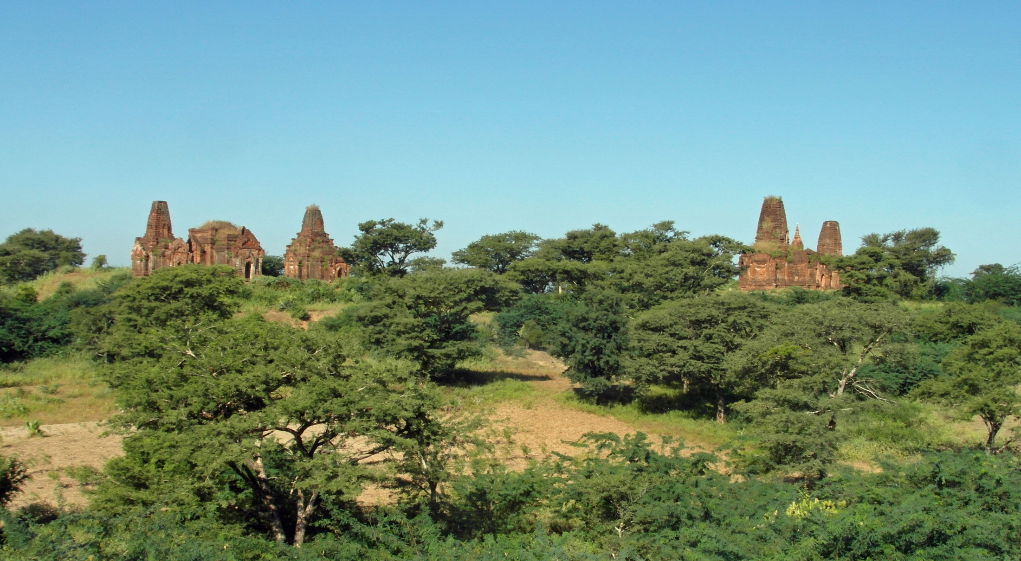
Pagodes and temples are greeting.

Slide 6
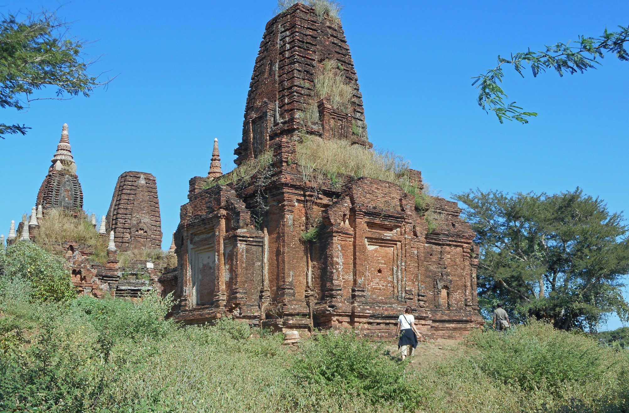
This is a large one …

Slide 7
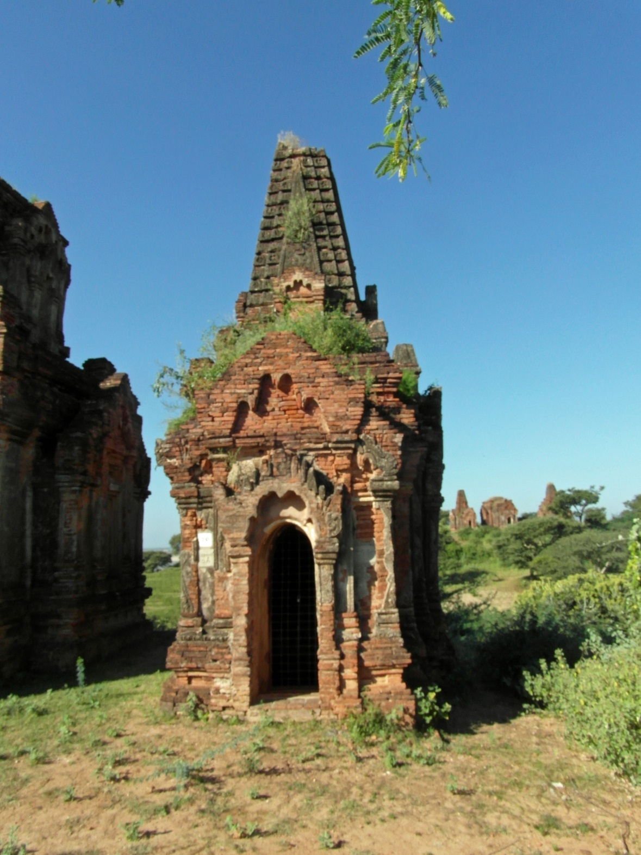
…this is a small one …

Slide 8
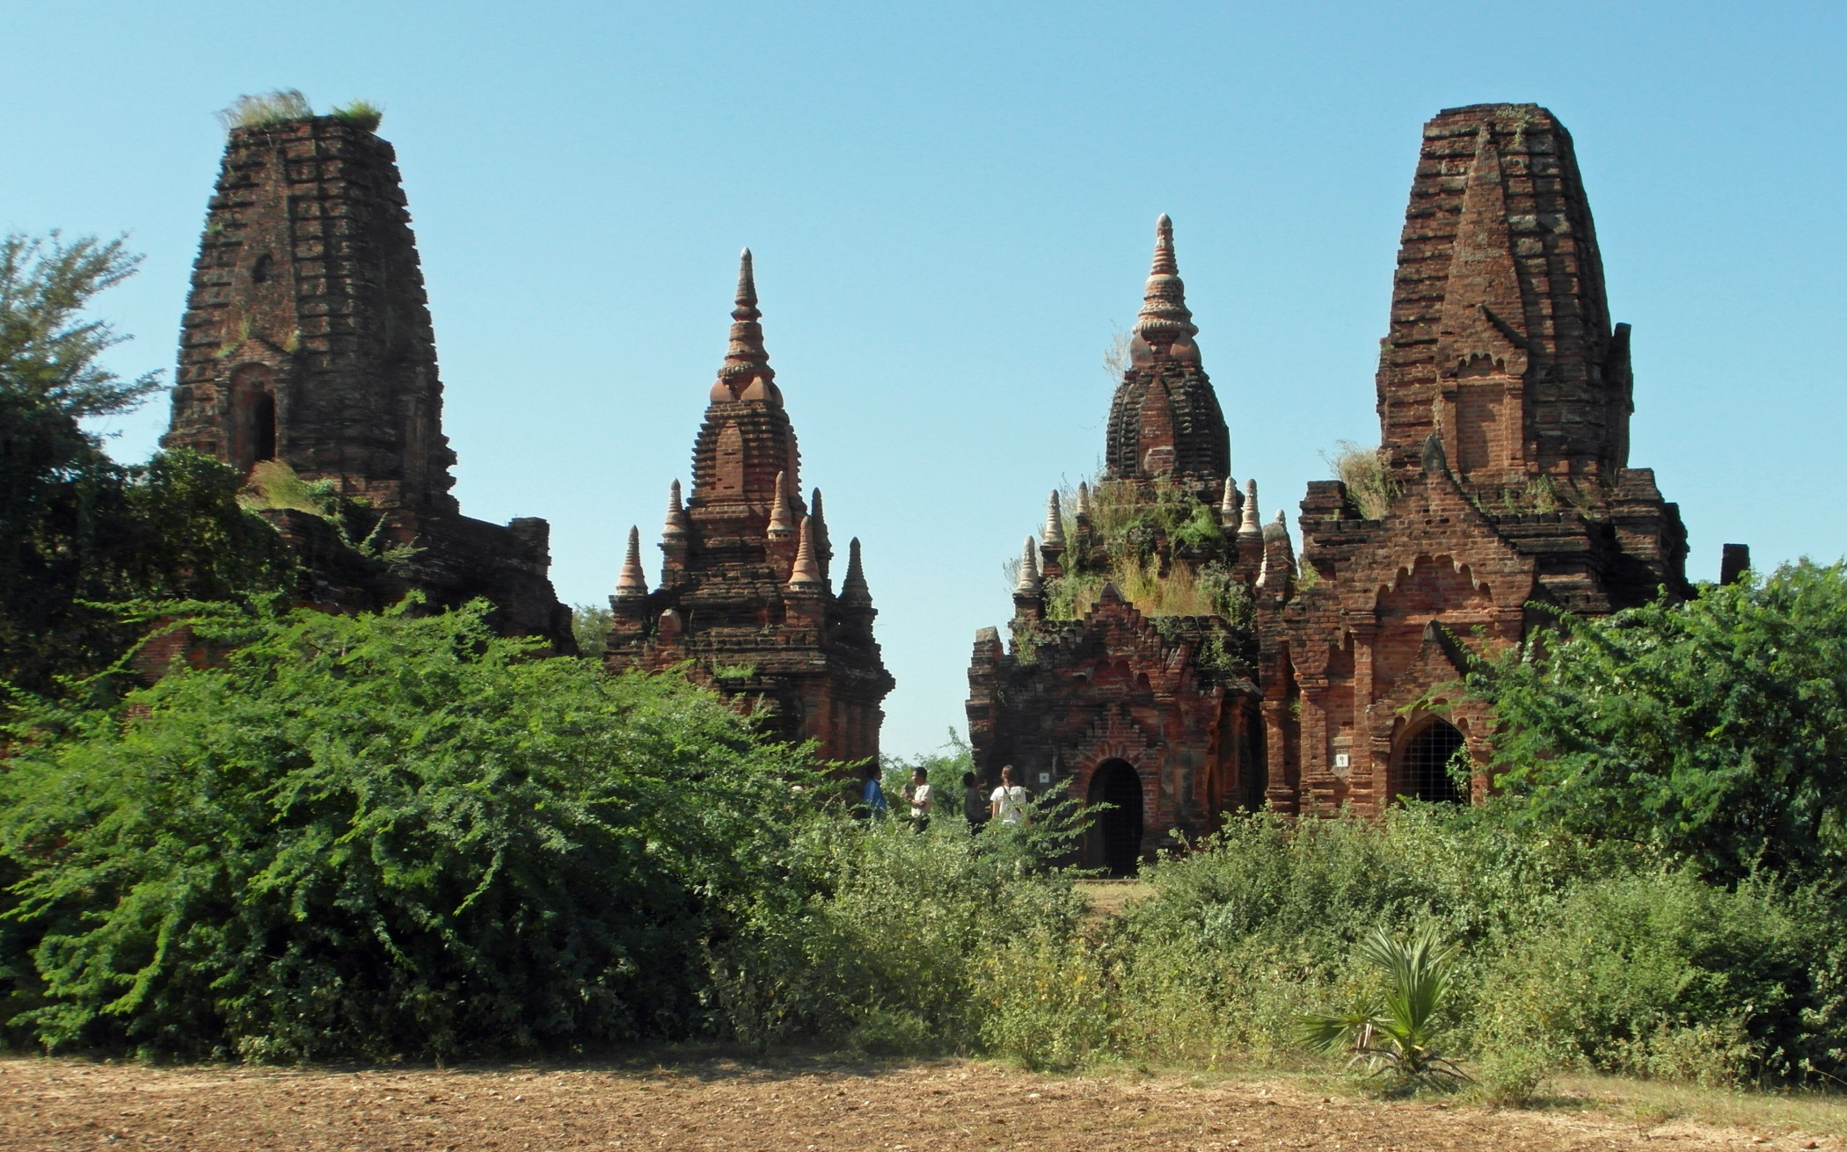
…this is an impressive group ...

Slide 9
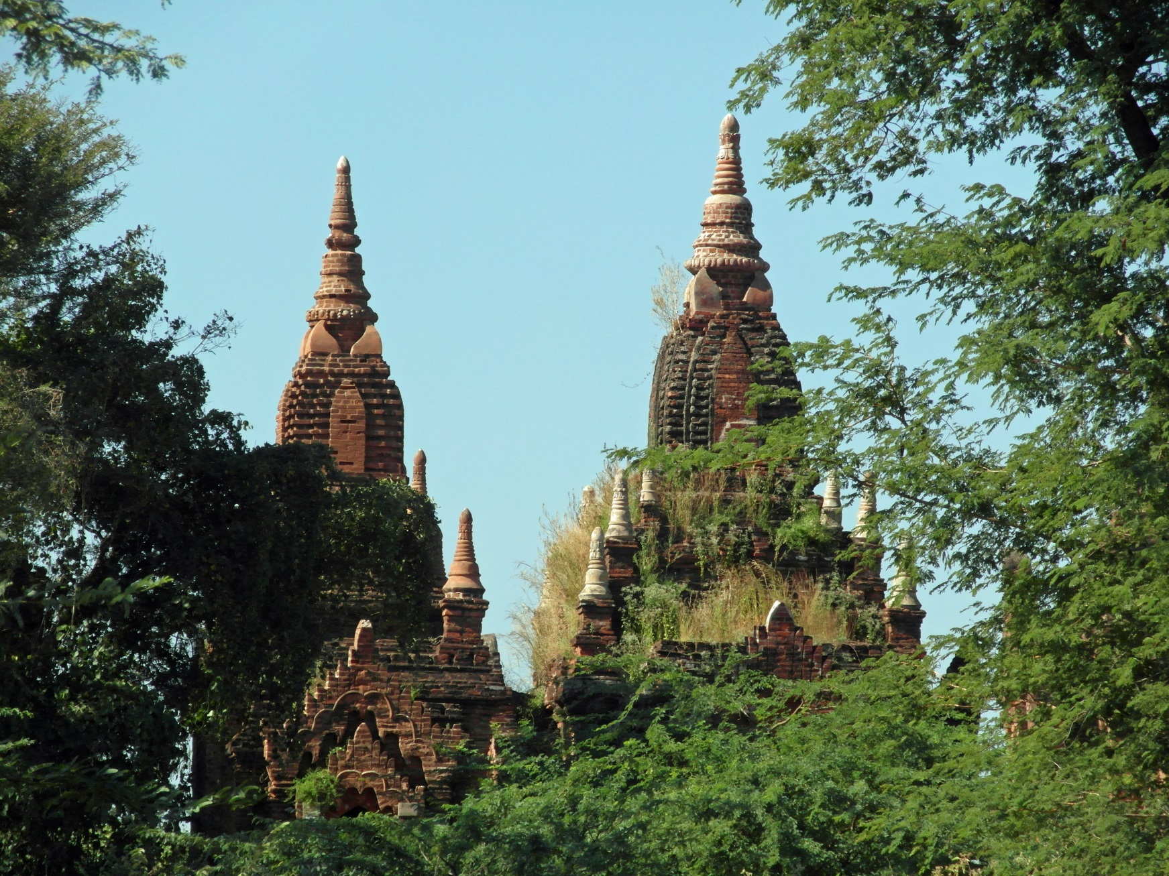
… and this view is even more charming.

Slide 10
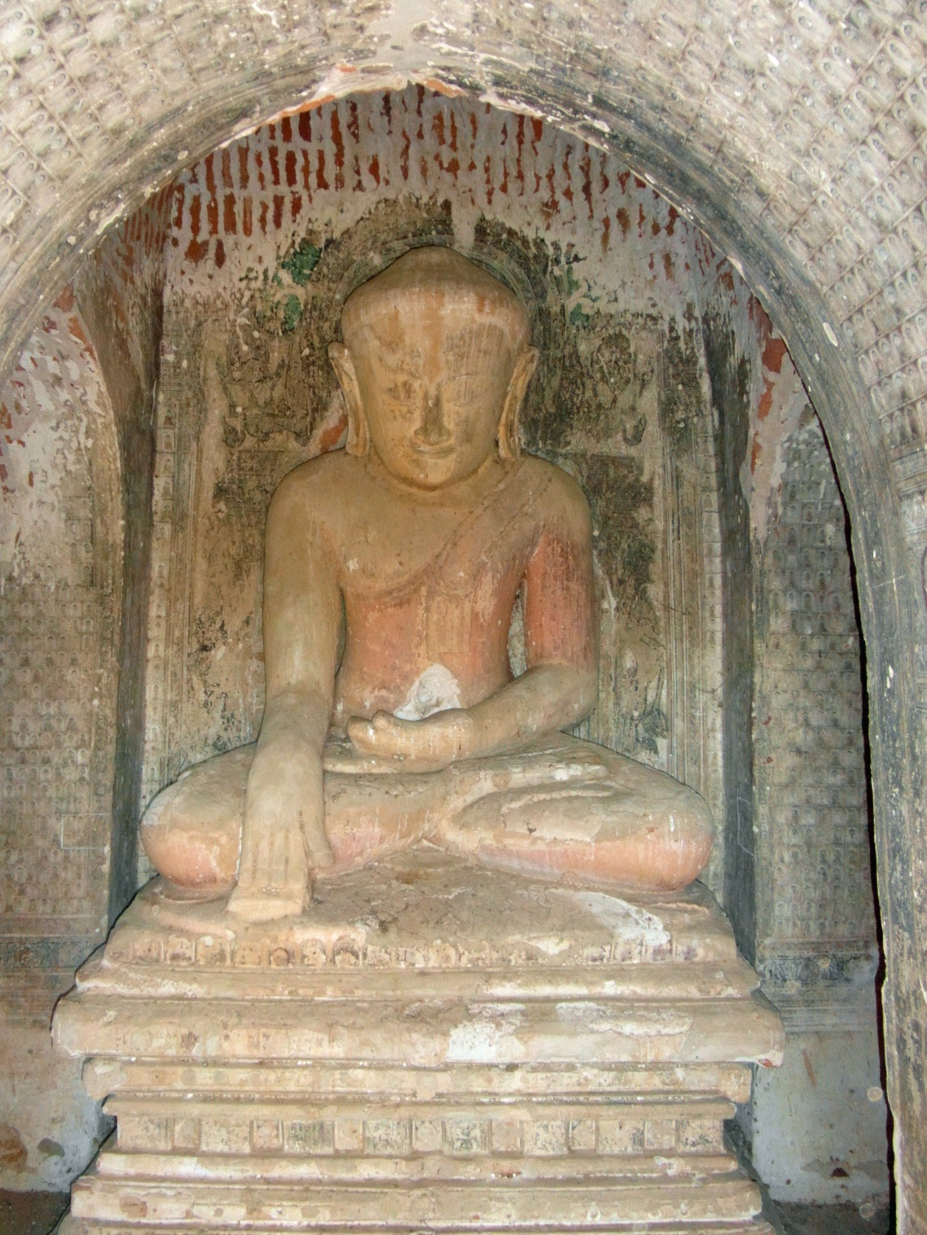
In some pagodes, Buddha is still calling the earth.

Slide 11
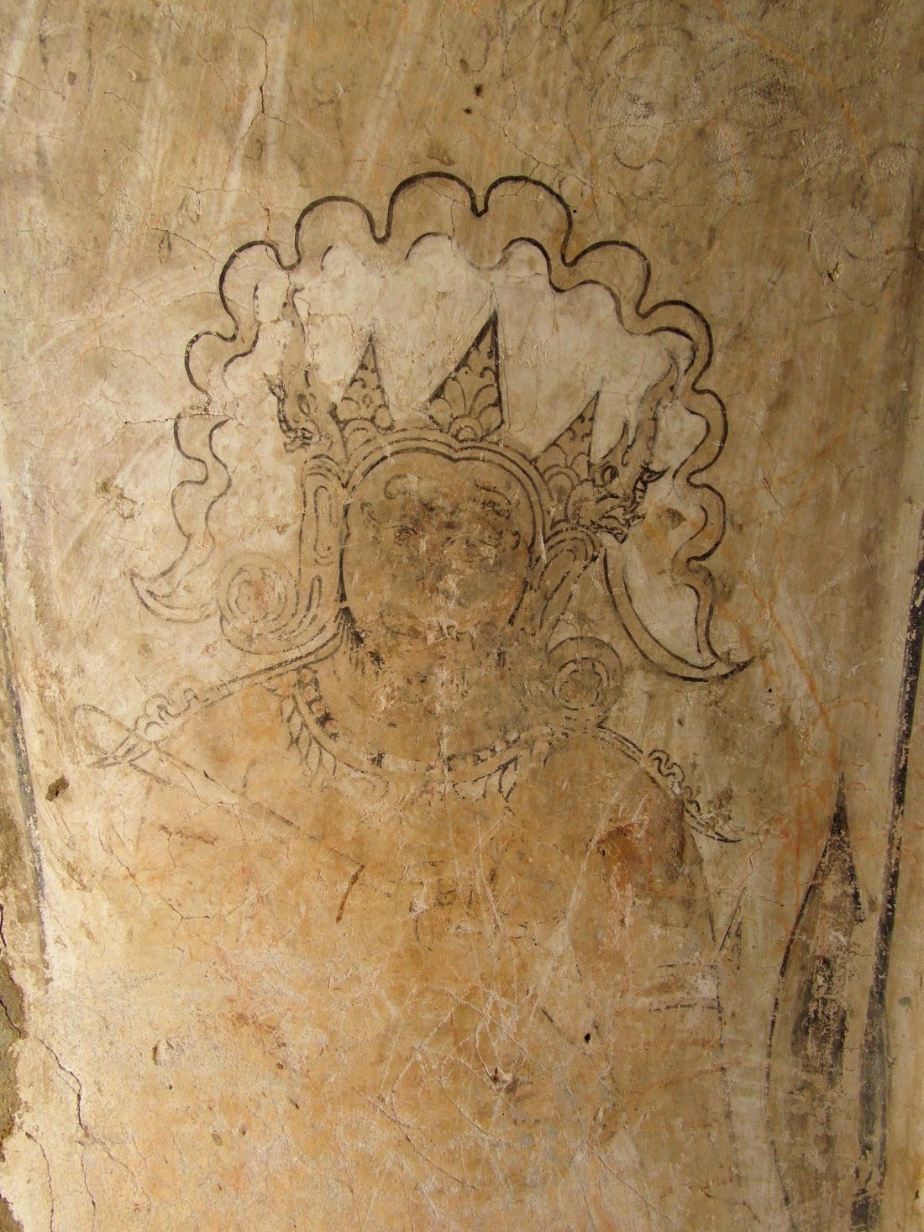
King and Queen are at the entrance – here is the queen.

Slide 12
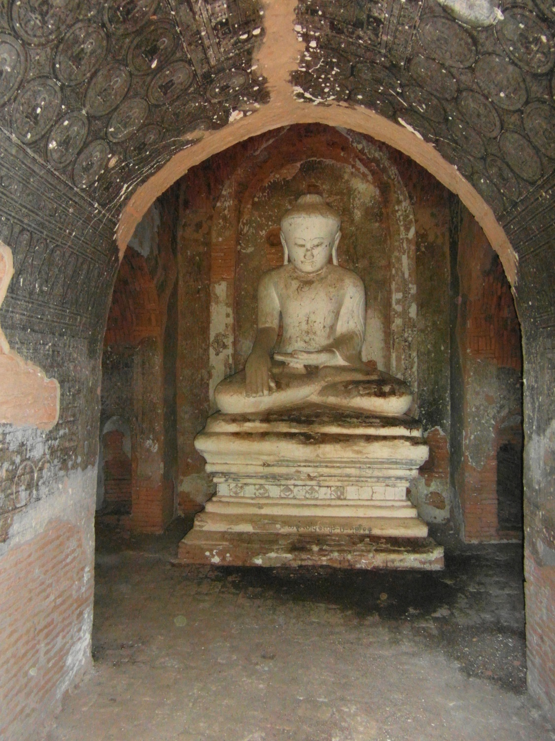
No – or no more – queen here.

Slide 13
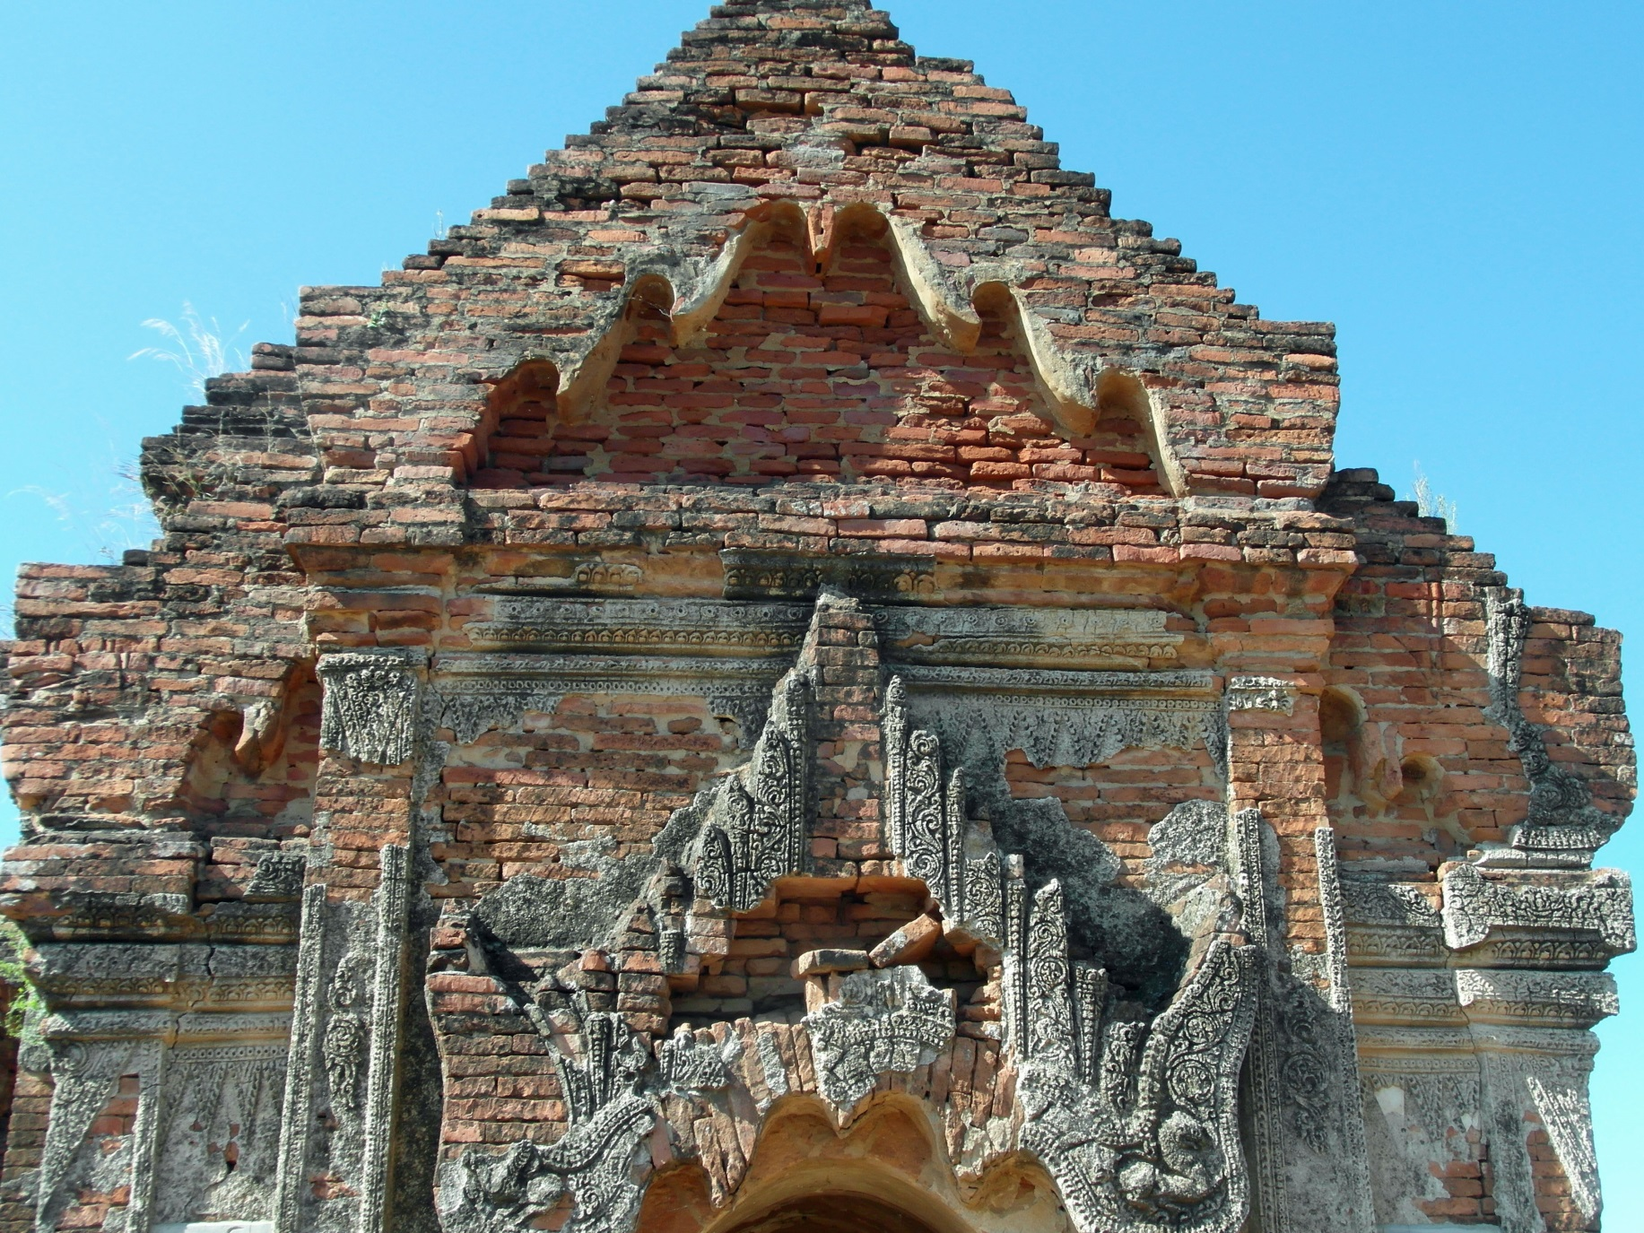
Much plaster has fallen off …

Slide 14
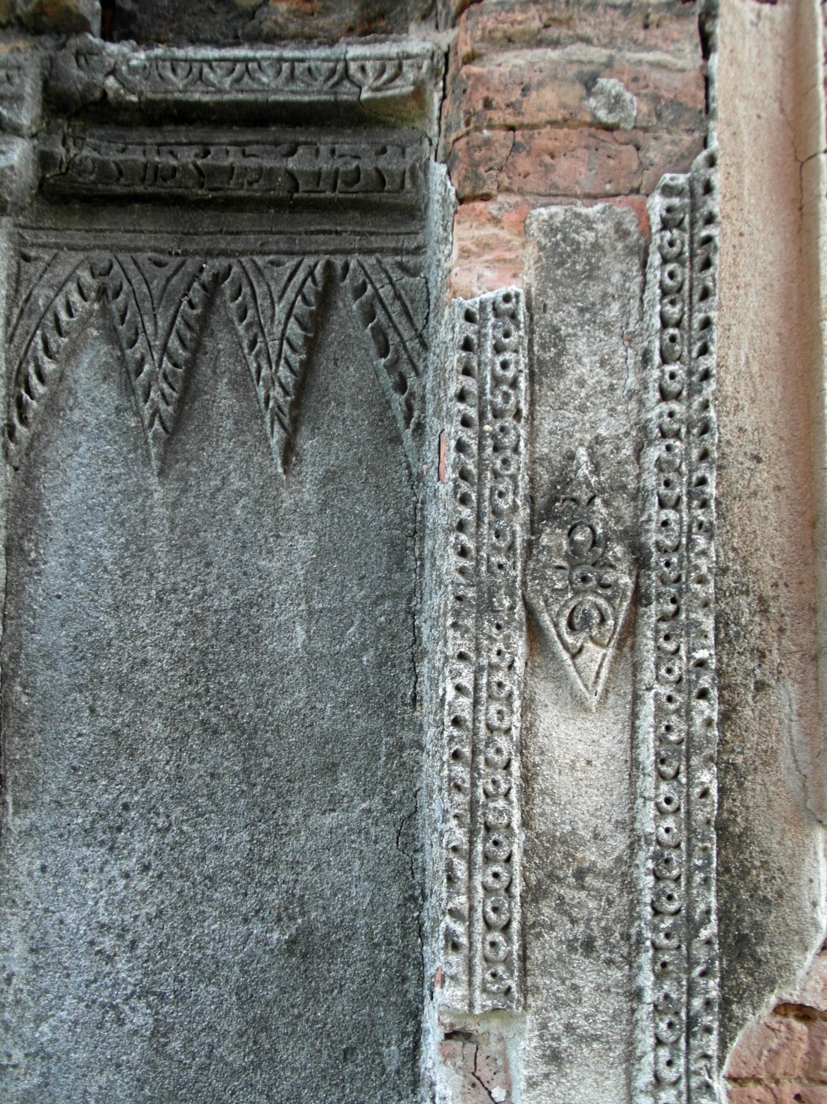
…some plaster ornaments persist …

Slide 15
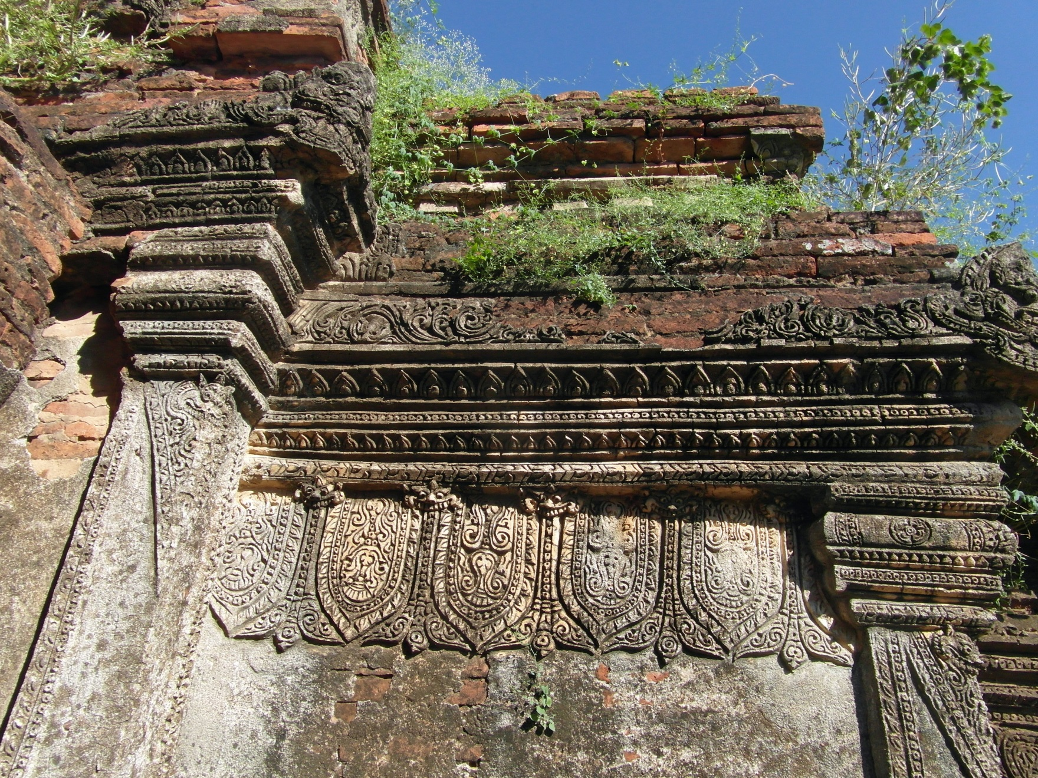
... but nature is taking over.

Slide 16
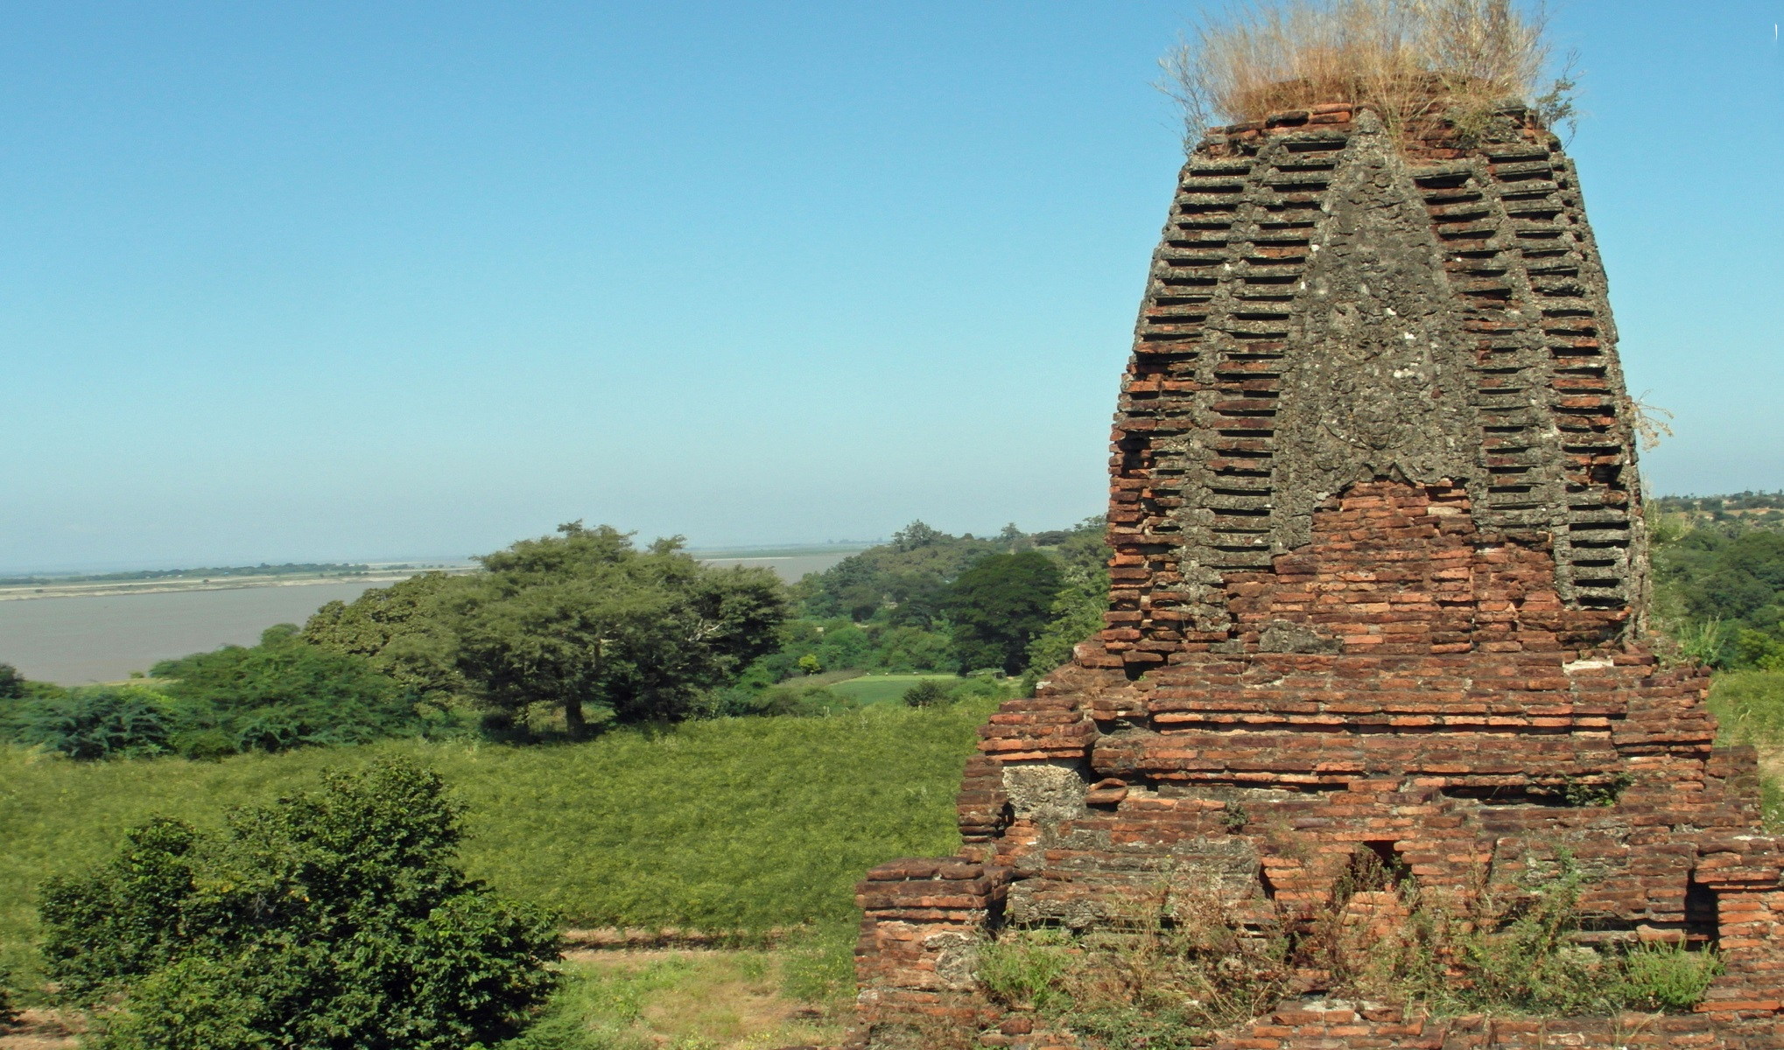
View from the top to another top ...

Slide 17
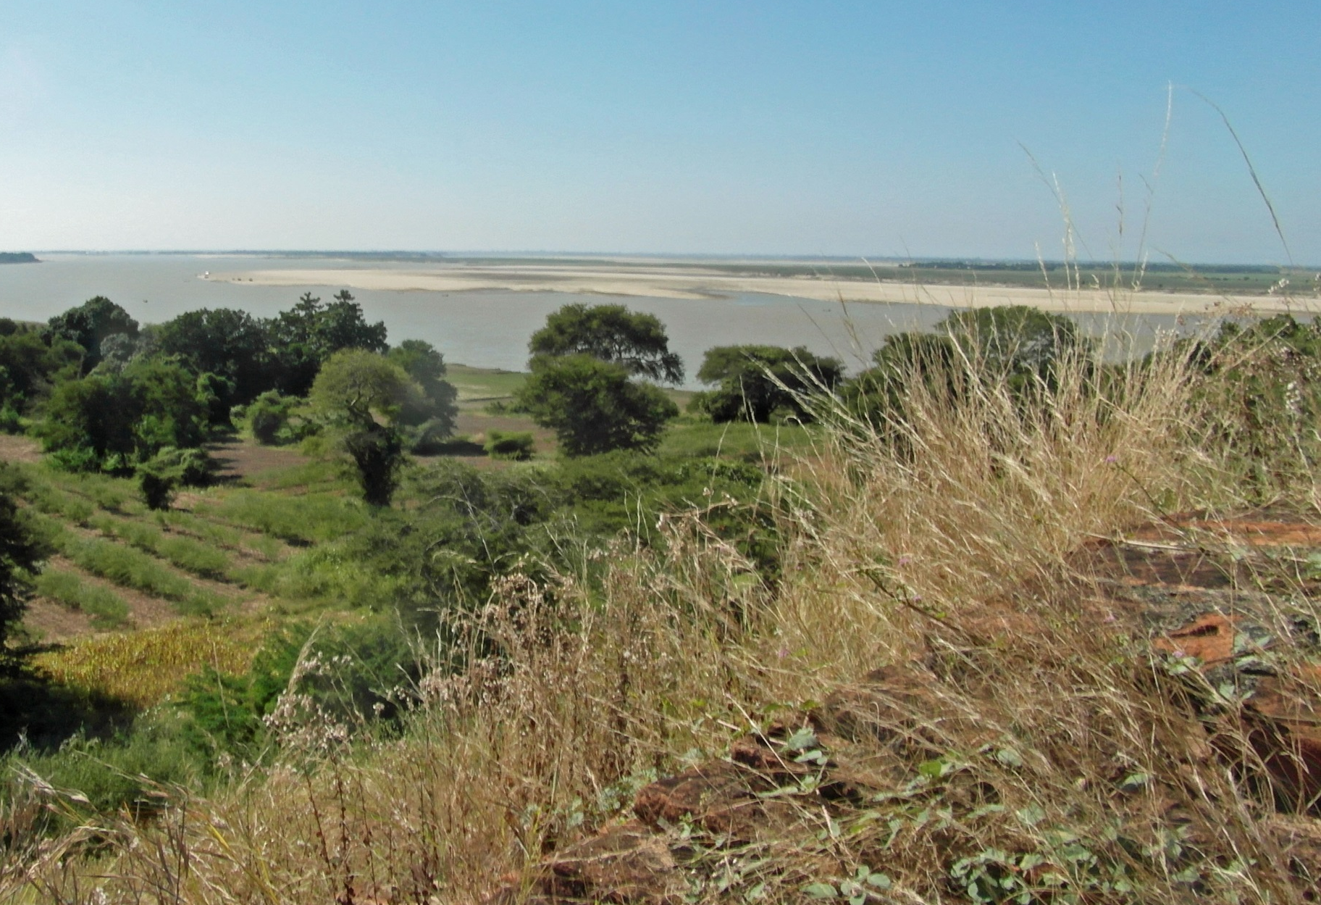
… and to the plains and the river.

Slide 18
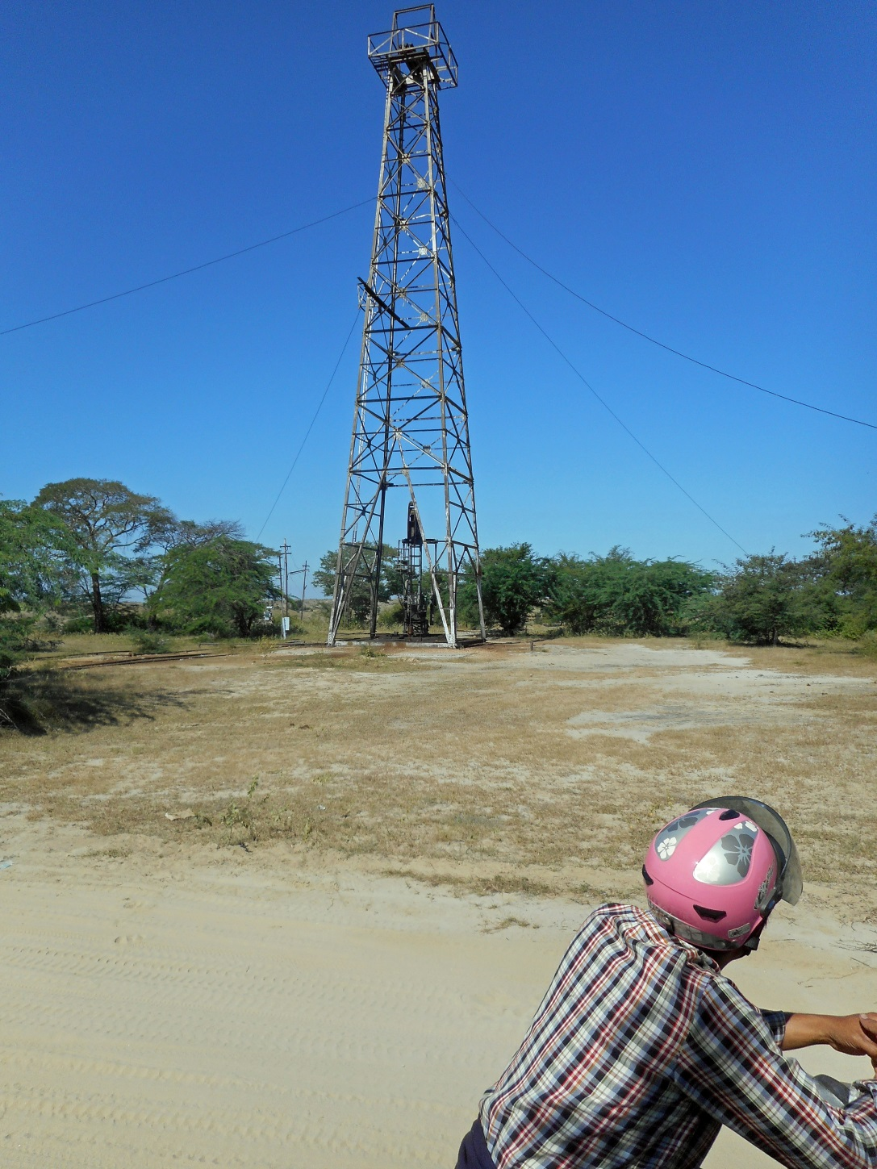
On the way back: a non-religious pagode …

Slide 19
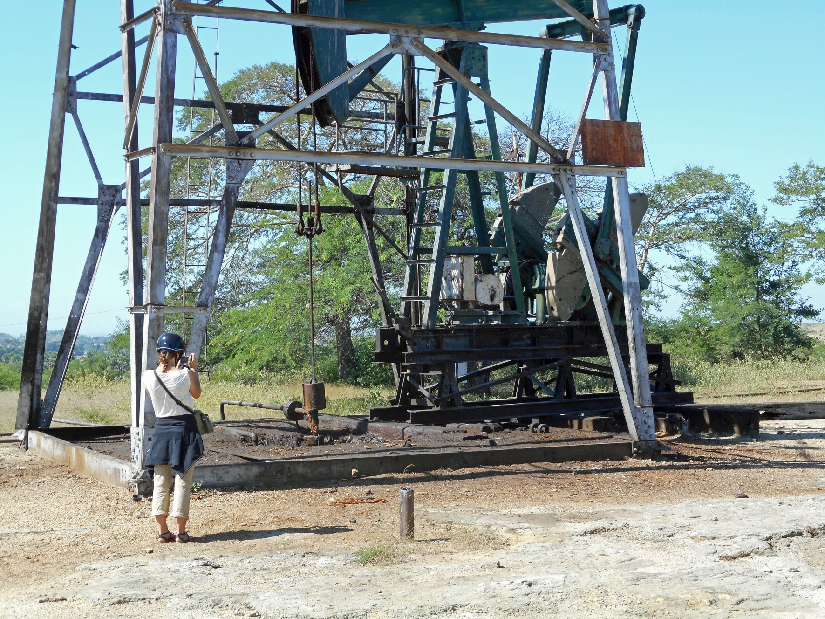
… with an oil pump and an engineer …

Slide 20
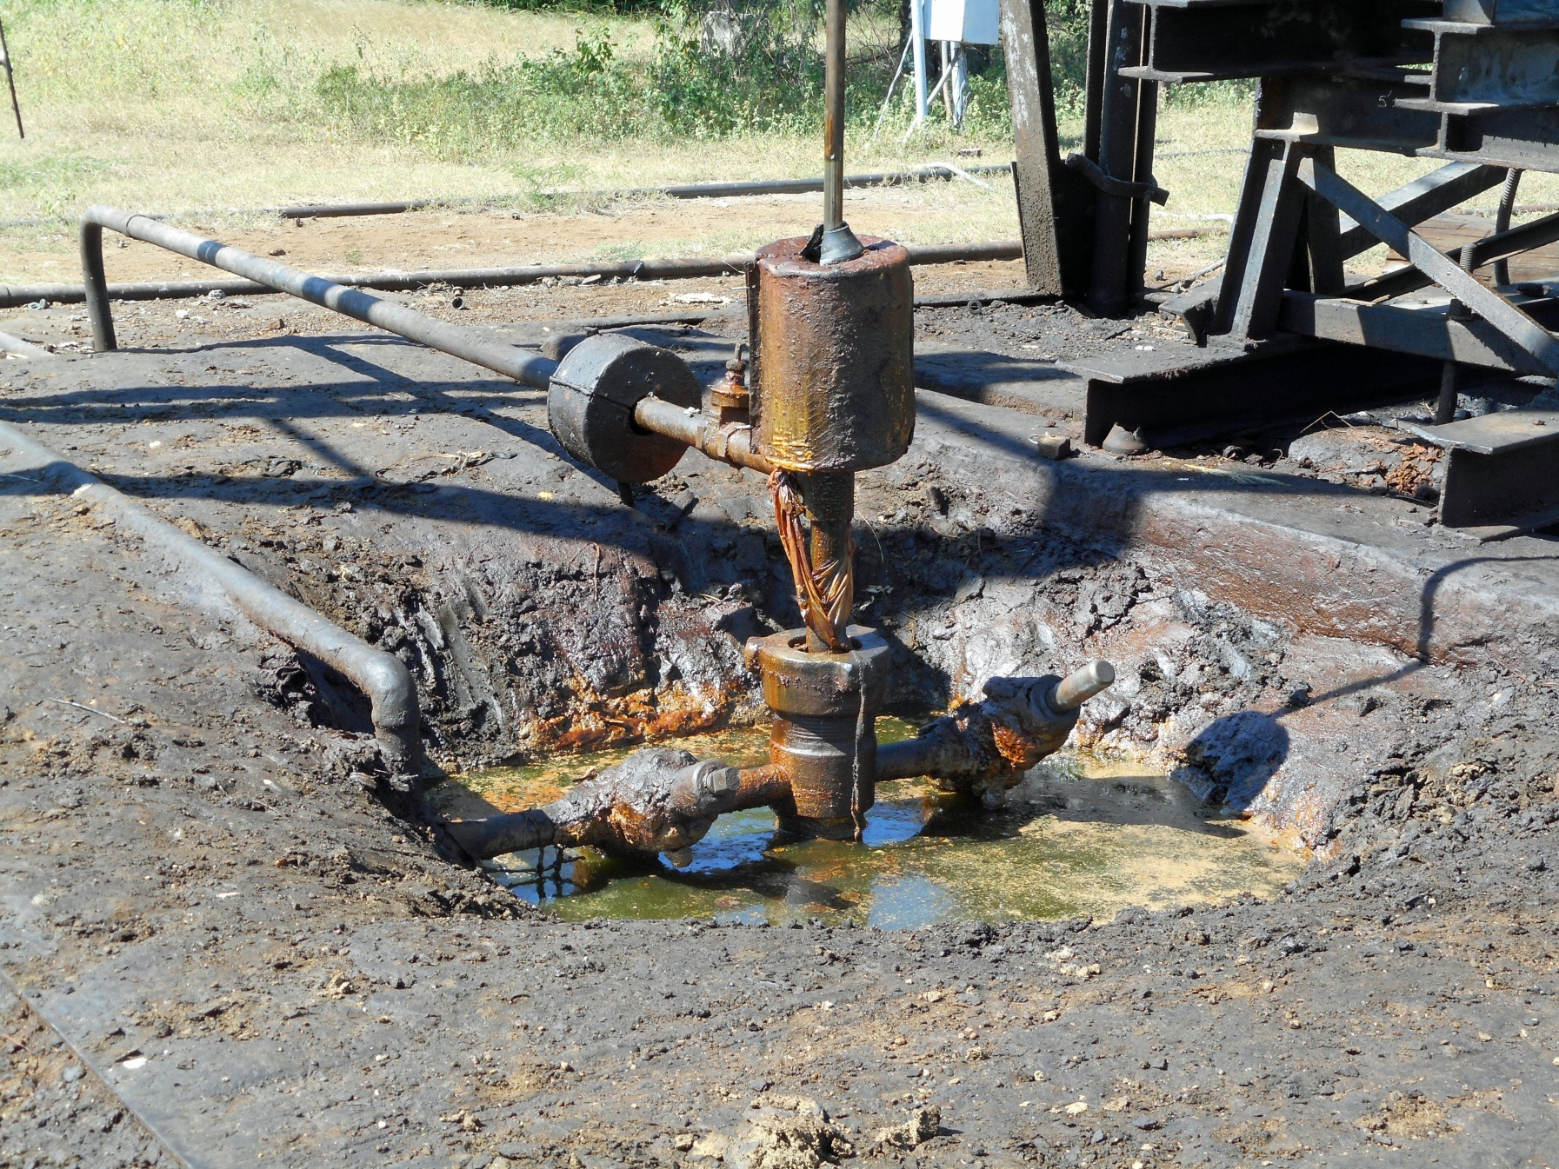
… and a colourful outlet.

Slide 21
That was it, on November 21, 2015!

